Slide 1
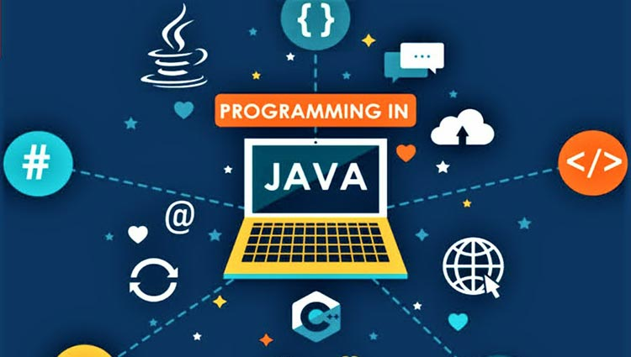
PROGRAMMING IN JAVA – U23ITTC02

Slide 2
Course Outcomes
CO1: Articulate the concept of Java fundamentals, OOPs and Strings (K2)
CO2: Demonstrate the principles of inheritance, packages and interfaces with real time applications (K3)
CO3: Create real time applications using exception handling and thread programming. (K3)
CO4: Build distributed applications using Collections and IO streams (K3)
CO5: Design and build simple GUI programs using AWT, Swings and build database applications (K3)

Slide 3
Syllabus
UNIT I- INTRODUCTION
Introduction: Java: History – Features – JVM - JRE – JDK – Java Compilation and Execution – Data Types - Variables, Types, Expressions, Assignment Statements, Input/Output Statements: Scanner/System class,Type Casting (Primitives to Primitives), Conditional and Iterative Control Structures – Arrays
OOPs with Java: Introduction to OOPs Concepts - Class – Objects – Methods - Access Modifiers – Creating Class and Objects, Object Life-Cycle - Garbage Collection-Constructors - this – static – Array of Objects – Nested Classes.
String: String Class– Built-in Methods – StringBuilder – StringBuffer
UNIT II- INHERITANCE, INTERFACES AND PACKAGES
Inheritance: Types of Inheritance – is-a Relationship, has-a Relationship – super keyword – final keyword – Polymorphism - Method overloading and Method overriding – Abstract Class
Interfaces: Define – Extend – Implement – Access - Interfaces vs Abstract classes,
Type Conversions (Primitives to Objects vice-versa): Autoboxing and Auto unboxing
Packages: Define – Create – Access – Import
UNIT III- EXCEPTIONHANDLING AND MULTITHREADING
Exception Handling: Exception Hierarchy – Checked and Unchecked Exceptions – try, catch, throws, throw and finally– User Defined Exceptions.
Multithreading: Thread – Life cycle – Defining and Running – Implementation Types – Thread Priorities – Thread Synchronization - Inter-Thread Communication
UNIT IV –COLLECTIONS AND I/OSTREAMS
Collections: List: ArrayList and LinkedList. Set: HashSet and TreeSet. Map: HashMap – Stack – Queue. Lambda Expressions.
I/O Streams: Streams – Byte Streams and Character Streams – FileInputStream and FileOutputStream – FileReader and FileWriter.
Object Serialization : ObjectInputStream and ObjectOutputStream
UNIT V – GUI AND JDBC
AWT: Components – Controls – Event Handling. SWING: Swing Components – Layout Management.
JDBC: JDBC Architecture – JDBC Driver Types – Implementation of JDBC.

Slide 4
Text Books and References
Text Books:
Allen B. Downey and Chris Mayeld, “Think Java - How to Think Like a Computer Scientist”, 2nd Edition, Green Tea Press, 2020
Herbert Schildt, “Java: The Complete Reference”, TMH Publishing Company Ltd, 11th Edition, 2018.
H.M.Dietel and P.J.Dietel, “Java How to Program”, 11th Edition, Pearson Education/PHI, 2017
Cay S. Horstmann, Gary Cornell, “Core Java Volume - I Fundamentals”, 9th Edition, Prentice Hall, 2013.
Reference Books:
Sagayaraj, Denis, Karthik, Gajalakshmi, “JAVA Programming for core and advanced learners”, Universities Press Private Limited, 2018.
Poaul Deitel, Harvey Deitel, “Java SE 8 for programmers”, 3rd Edition, Pearson, 2015.
P.J. Dietel and H.M Dietel, “Java for Programmers”, Pearson Education, 9th Edition, 2011.
Steven Holzner, “Java 2 Black book”, Dreamtech Press, 2011.

Slide 5
Text Books and References
Web References
1. https://www.javatpoint.com/java-tutorial
2. https://docs.oracle.com/en/java/
3. https://www.studytonight.com/java/
4. https://onlinecourses.nptel.ac.in/

Slide 6
UNIT I
INTRODUCTION
Introduction: Java: History – Features – JVM - JRE – JDK – Java Compilation and Execution – Data Types - Variables, Types, Expressions, Assignment Statements, Input / Output Statements: Scanner/System class, Type Casting (Primitives to Primitives), Conditional and Iterative Control Structures – Arrays
OOPs with Java: Introduction to OOPs Concepts - Class – Objects – Methods - Access Modifiers – Creating Class and Objects, Object Life-Cycle - Garbage Collection-Constructors - this – static – Array of Objects – Nested Classes.
String: String Class– Built-in Methods – String Builder – String Buffer

Slide 7
INTRODUCTION TO PROGRAMMING
A computer is a device that can accept human instruction, processes it and responds to it or a computer is a computational device which is used to process the data under the control of a computer program. Program is a sequence of instruction along with data.
The basic components of a computer are:
Input unit
Central Processing Unit(CPU)
Output unit
The CPU is further divided into three parts-
Memory unit
Control unit
Arithmetic Logic unit

Slide 8
A program is a set of instructions given to a computer to perform a specific operation.
While executing the program, raw data is processed into a desired output format.
These computer programs are written in a programming language which are high level languages.
High level languages are nearly human languages which are more complex then the computer understandable language which are called machine language, or low level language.
So after knowing the basics, we are ready to create a very simple and basic program. Like we have different languages to communicate with each other, likewise, we have different languages like C, C++, C#, Java, python, etc to communicate with the computers.
The computer only understands binary language (the language of 0’s and 1’s) also called machine-understandable language or low-level language but the programs we are going to write are in a high-level language which is almost similar to human language.

Slide 9
Hierarchy of Computer language –

Slide 10
There have been many programming language some of them are listed below:
C
Python
C++
C#
R
Ruby
COBOL
ADA
Java
Fortran
BASIC
Altair BASIC
True BASIC
Visual BASIC
GW BASIC
QBASIC
PureBASIC
PASCAL
Turbo Pascal
GO
ALGOL
LISP
SCALA
Swift
Rust
Prolog
Reia
Racket
Scheme
Shimula
Perl
PHP
JavaScript
Coffee Script
Visual FoxPro
Babel
Logo
Lua
Smalltalk
Matlab
F
F#
Dart
Datalog
Dbase
Haskell
Dylan
Julia
Ksh
Metro
Mumps
Nim
Ocaml
Pick
TCL
D
CPL
Curry
Action Script
Erlang
Clojure
DarkBASCIC
Assembly

Slide 11
Most Popular Programming Languages –
C
Python
C++
Java
SCALA
C#
R
Ruby
Go
Swift
JavaScript

Slide 12
Characteristics of a programming Language
A programming language must be simple, easy to learn and use, have good readability and human recognizable.
Abstraction is a must-have Characteristics for a programming language in which ability to define the complex structure and then its degree of usability comes.
A portable programming language is always preferred.
Programming language’s efficiency must be high so that it can be easily converted into a machine code and executed consumes little space in memory.
A programming language should be well structured and documented so that it is suitable for application development.
Necessary tools for development, debugging, testing, maintenance of a program must be provided by a programming language.
A programming language should provide single environment known as Integrated Development Environment(IDE).
A programming language must be consistent in terms of syntax and semantics.

Slide 13
What is Java?
Java is a high-level, object-oriented programming language designed with the motto “write once, run anywhere”, meaning the same compiled program can run on different platforms that have a Java Virtual Machine (JVM).
It is widely used for web applications, Android apps, desktop applications, and enterprise systems because of its portability, large standard library, and strong community support.

Slide 14
The History and Evolution of Java
The history of Java is very interesting. Java was originally designed for interactive television, but it was too advanced technology for the digital cable television industry at the time.
The history of Java starts with the Green Team. Java team members (also known as Green Team), initiated this project to develop a language for digital devices such as set-top boxes, televisions, etc.
However, it was suited for internet programming. Later, Java technology was incorporated by Netscape.
The principles for creating Java programming were "Simple, Robust, Portable, Platform-independent, Secured, High Performance, Multithreaded, Architecture Neutral, Object-Oriented, Interpreted, and Dynamic".
Java was developed by James Gosling, who is known as the father of Java, in 1995. James Gosling and his team members started the project in the early '90s.

Slide 15
Currently, Java is used in internet programming, mobile devices, games, e-business solutions, etc. There are given significant points that describe the history of Java.
James Gosling, Mike Sheridan, and Patrick Naughton initiated the Java language project in June 1991. The small team of sun engineers called Green Team.
Initially designed for small, embedded systems in electronic appliances like set-top boxes.
Firstly, it was called "Greentalk" by James Gosling, and the file extension was .gt.
After that, it was called Oak and was developed as a part of the Green project.
Why Java named "Oak"?
Why Oak? Oak is a symbol of strength and chosen as a national tree of many countries like the U.S.A., France, Germany, Romania, etc.
In 1995, Oak was renamed as "Java" because it was already a trademark by Oak Technologies.

Slide 16
Why Java Programming named "Java"?
Why had they chosen java name for Java language?
The team gathered to choose a new name. The suggested words were "dynamic", "revolutionary", "Silk", "jolt", "DNA", etc. They wanted something that reflected the essence of the technology: revolutionary, dynamic, lively, cool, unique, and easy to spell and fun to say.
According to James Gosling, "Java was one of the top choices along with Silk". Since Java was so unique, most of the team members preferred Java than other names.
Java is an island of Indonesia where the first coffee was produced (called java coffee). It is a kind of espresso bean. Java name was chosen by James Gosling while having coffee near his office.
Notice that Java is just a name, not an acronym.

Slide 17
Initially developed by James Gosling at Sun Microsystems (which is now a subsidiary of Oracle Corporation) and released in 1995.
In 1995, Time magazine called Java one of the Ten Best Products of 1995.
JDK 1.0 released in(January 23, 1996). After the first release of Java, there have been many additional features added to the language. Now Java is being used in Windows applications, Web applications, enterprise applications, mobile applications, cards, etc. Each new version adds the new features in Java.

Slide 18
Java platform components
JVM (Java Virtual Machine): Executes compiled Java bytecode and provides a platform-independent runtime environment.
JRE (Java Runtime Environment): Includes the JVM and core libraries needed to run Java programs; used by end users.
JDK (Java Development Kit): Includes JRE plus compilers and development tools; required for writing and compiling Java code.

Slide 19
Java Versions
Version | Release date | End of Free Public Updates | Extended Support Until
JDK Beta | 1995 | ? | ?
JDK 1.0 | January 1996 | ? | ?
JDK 1.1 | February 1997 | ? | ?
J2SE 1.2 | December 1998 | ? | ?
J2SE 1.3 | May 2000 | ? | ?
J2SE 1.4 | February 2002 | October 2008 | February 2013
J2SE 5.0 | September 2004 | November 2009 | April 2015
Java SE 6 | December 2006 | April 2013 | December 2018 December 2023, paid support for Zulu^{[8]}
Java SE 7 | July 2011 | April 2015 | July 2022
Java SE 8 (LTS) | March 2014 | January 2019 for Oracle (commercial) December 2030 for Oracle (non-commercial) December 2030 for Zulu At least May 2026 for AdoptOpenJDK At least May 2026 for Amazon Corretto | December 2030
Java SE 9 | September 2017 | March 2018 for OpenJDK | N/A
Java SE 10 | March 2018 | September 2018 for OpenJDK | N/A
Java SE 11 (LTS) | September 2018 | September 2027 for Zulu At least October 2024 for AdoptOpenJDK At least September 2027 for Amazon Corretto | September 2026, or September 2027 for e.g. Zulu^{[8]}
Java SE 12 | March 2019 | September 2019 for OpenJDK | N/A
Java SE 13 | September 2019 | March 2020 for OpenJDK | N/A
Java SE 14 | March 2020 | September 2020 for OpenJDK | N/A
Java SE 15 | September 2020 | March 2021 for OpenJDK, March 2023 for Zulu^{[8]} | N/A
Java SE 16 | March 2021 | September 2021 for OpenJDK | N/A

Slide 20
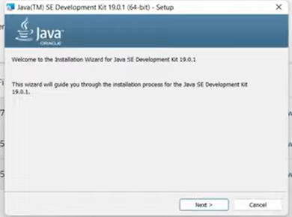
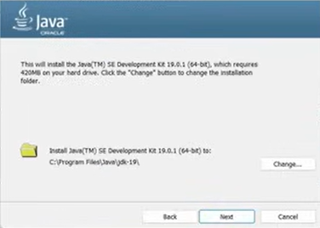
Latest Version
Java 25
JDK 25.0.1
https://www.oracle.com/in/java/technologies/downloads/#jdk25-windows
MicroSoft Installer (MSI)
https://download.oracle.com/java/25/latest/jdk-25_windows-x64_bin.msi

Slide 21
Setting up Java environment variables
Creating the JAVA_HOME variable and
Updating the system PATH variable
Ensure the Java Development Kit (JDK) is installed before proceeding. You can download the latest JDK from the Oracle website.
Windows (10/11)
Access Environment Variables:
Search for "environment variables" in the Start menu and select Edit the system environment variables.
In the System Properties dialog box, click the Environment Variables... button.
Set JAVA_HOME System Variable:
Under System variables, click New....
Enter JAVA_HOME in the Variable name field.
For Variable value, enter the path to your JDK installation directory (e.g., C:\Program Files\Java\jdk-25). Do not include the \bin folder path here.
Click OK.

Slide 22
Update the Path System Variable:
In the System variables section, select the Path variable and click Edit....
In the Edit environment variable window, click New and type %JAVA_HOME%\bin.
Click OK on all open windows to save the changes.
Verify Setup:
Open a new Command Prompt or PowerShell window (existing windows won't reflect the changes).
Type java --version and press Enter.
Type javac --version and press Enter.
If the version information is displayed without errors, the setup is successful.

Slide 23
classes and objects
Java is object-oriented: programs are built from classes (blueprints) and objects (instances).
A class defines fields (data) and methods (behavior);
An object is a real-world entity that represents:
State → data / variables
Behavior → methods / functions
Identity → memory reference (unique)
An object is an instance of a class. It is a runtime entity created from a class, which occupies memory and contains data members and member functions.
An object represents a specific entity created from that class using the new keyword,
Example
Student s = new Student();

Slide 24
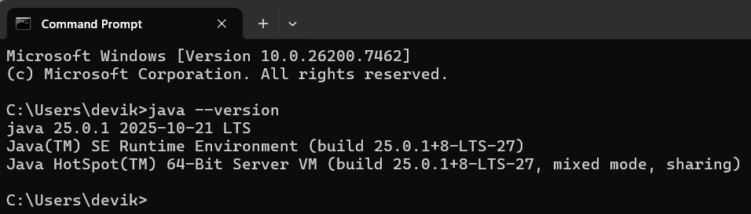
--version

Slide 25
Basic syntax and rules
A Java source file has extension .java and usually contains one public class with the same name as the file.
Java is case-sensitive (main and Main are different), statements end with a semicolon ;, and blocks of code are enclosed in curly braces {}.
Variables and data types
A variable is a named storage location with a type, such as int x = 10; or double price = 99.5;.
Java has primitivetypes (e.g., byte, short, int, long, float, double, char, boolean) and reference types (classes, arrays, interfaces, etc.).

Slide 26
First Java Program
Create a New Folder
Right click -> New text file -> Rename filename.txt as classname.java -> Open with notepad
Write your first program
class Helloworld //every application must have at least one class
{
public static void main(String[] args) //entry point
{
System.out.println("Helloworld!");
//prints text to the console
}
}

Slide 27
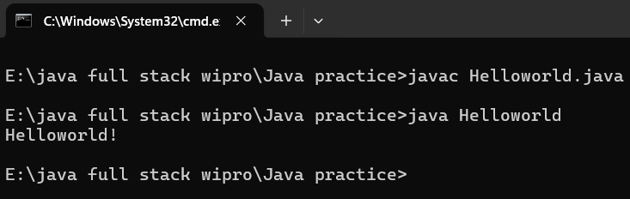
Compile and Run
Save file
In current working directory – Click on the address bar – type cmd – opens command prompt

Slide 28
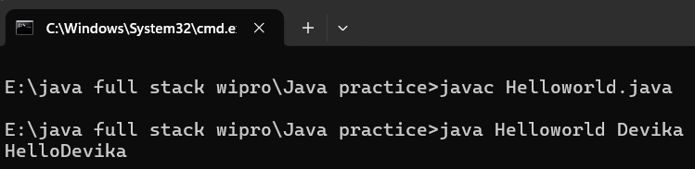
class Helloworld
{
public static void main(String[] args)
{
String name=args[0];
System.out.println("Hello" + name);
}
}

Slide 29
Java terminology
Java Virtual Machine (JVM) This is generally referred as JVM. Before, we discuss about JVM lets see the phases of program execution. Phases are as follows: we write the program, then we compile the program and at last we run the program. 1) Writing of the program is of course done by java programmer like you and me. 2) Compilation of program is done by javac compiler, javac is the primary java compiler included in java development kit (JDK). It takes java program as input and generates java bytecode as output. 3) In third phase, JVM executes the bytecode generated by compiler. This is called program run phase.
So, now that we understood that the primary function of JVM is to execute the bytecode produced by compiler. Each operating system has different JVM, however the output they produce after execution of bytecode is same across all operating systems. That is why we call java as platform independent language.

Slide 30
Bytecode As discussed above, javac compiler of JDK compiles the java source code into bytecode so that it can be executed by JVM. The bytecode is saved in a .class file by compiler.
Java Development Kit(JDK) While explaining JVM and bytecode, I have used the term JDK. Let’s discuss about it. As the name suggests this is complete java development kit that includes JRE (Java Runtime Environment), compilers and various tools like JavaDoc, Java debugger etc. In order to create, compile and run Java program you would need JDK installed on your computer.
Java Runtime Environment(JRE) JRE is a part of JDK which means that JDK includes JRE. When you have JRE installed on your system, you can run a java program however you won’t be able to compile it. JRE includes JVM, browser plugins and applets support. When you only need to run a java program on your computer, you would only need JRE.

Slide 31
Garbage Collector
In Java, programmers can’t delete the objects. To delete or recollect that memory JVM has a program called Garbage Collector.
Garbage Collector can recollect the of objects that are not referenced. So Java makes the life of a programmer easy by handling memory management.
However, programmers should be careful about their code whether they are using objects that have been used for a long time. Because Garbage cannot recover the memory of objects being referenced.
ClassPath
The classpath is the file path where the java runtime and Java compiler looks for .class files to load. By default, JDK provides many libraries. If you want to include external libraries they should be added to the classpath.

Slide 32
Java Byte Code
Java bytecode is the instruction set for the Java Virtual Machine. It acts similar to an assembler which is an alias representation of a C++ code.
As soon as a java program is compiled, java bytecode is generated. In more apt terms, java bytecode is the machine code in the form of a .class file.
With the help of java bytecode we achieve platform independence in java.

Slide 33
How does it works?
When we write a program in Java, firstly, the compiler compiles that program and a bytecode is generated for that piece of code.
When we wish to run this .class file on any other platform, we can do so. After the first compilation, the bytecode generated is now run by the Java Virtual Machine and not the processor in consideration.
This essentially means that we only need to have basic java installation on any platforms that we want to run our code on.
Resources required to run the bytecode are made available by the Java Virtual Machine, which calls the processor to allocate the required resources.
JVM's are stack-based so they stack implementation to read the codes.

Slide 34
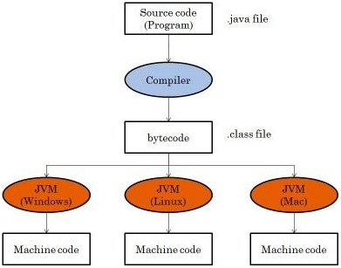

Slide 35
Advantage of Java Bytecode
Hence bytecode is a very important component of any java program.
The set of instructions for the JVM may differ from system to system but all can interpret the bytecode.
A point to keep in mind is that bytecodes are non-runnable codes and rely on the availability of an interpreter to execute and thus the JVM comes into play.
Bytecode is essentially the machine level language which runs on the Java Virtual Machine. Whenever a class is loaded, it gets a stream of bytecode per method of the class.

Slide 36
Whenever that method is called during the execution of a program, the bytecode for that method gets invoked.
Javac not only compiles the program but also generates the bytecode for the program. Thus, we have realized that the bytecode implementation makes Java a platform-independent language.
This helps to add portability to Java which is lacking in languages like C or C++. Portability ensures that Java can be implemented on a wide array of platforms like desktops, mobile devices, severs and many more.
Supporting this, Sun Microsystems captioned JAVA as "write once, read anywhere" or "WORA" in resonance to the bytecode interpretation.

Slide 37
Java Buzzwords or Features of Java
The primary objective of Java programming language creation was to make it portable, simple and secure programming language. Apart from this, there are also some excellent features which play an important role in the popularity of this language. The features of Java are also known as java buzzwords.
A list of most important features of Java language is given below.
Simple
Object-Oriented
Portable
Platform independent
Secured
Robust
Architecture neutral
Interpreted
High Performance
Multithreaded
Distributed
Dynamic

Slide 38
Simple
Java is very easy to learn, and its syntax is simple, clean and easy to understand. According to Sun, Java language is a simple programming language because:
Java syntax is based on C++ (so easier for programmers to learn it after C++).
Java has removed many complicated and rarely-used features, for example, explicit pointers, operator overloading, etc.
There is no need to remove unreferenced objects because there is an Automatic Garbage Collection in Java.
Object-oriented
Java is an object-oriented programming language. Everything in Java is an object. Object-oriented means we organize our software as a combination of different types of objects that incorporates both data and behavior.
Object-oriented programming (OOPs) is a methodology that simplifies software development and maintenance by providing some rules.

Slide 39
Platform Independent
Java is platform independent because it is different from other languages like C, C++, etc. which are compiled into platform specific machines while Java is a write once, run anywhere language. A platform is the hardware or software environment in which a program runs.
There are two types of platforms software-based and hardware-based. Java provides a software-based platform.
The Java platform differs from most other platforms in the sense that it is a software-based platform that runs on the top of other hardware-based platforms. It has two components:
Runtime Environment
API(Application Programming Interface)
Java code can be run on multiple platforms, for example, Windows, Linux, Sun Solaris, Mac/OS, etc. Java code is compiled by the compiler and converted into bytecode. This bytecode is a platform-independent code because it can be run on multiple platforms, i.e., Write Once and Run Anywhere(WORA).

Slide 40
Secured
Java is best known for its security. With Java, we can develop virus-free systems. Java is secured because:
No explicit pointer
Java Programs run inside a virtual machine sandbox
Classloader: Classloader in Java is a part of the Java Runtime Environment(JRE) which is used to load Java classes into the Java Virtual Machine dynamically. It adds security by separating the package for the classes of the local file system from those that are imported from network sources.
Bytecode Verifier: It checks the code fragments for illegal code that can violate access right to objects.
Security Manager: It determines what resources a class can access such as reading and writing to the local disk.
Java language provides these securities by default. Some security can also be provided by an application developer explicitly through SSL, JAAS, Cryptography, etc.

Slide 41
Robust
Robust simply means strong. Java is robust because:
It uses strong memory management.
There is a lack of pointers that avoids security problems.
There is automatic garbage collection in java which runs on the Java Virtual Machine to get rid of objects which are not being used by a Java application anymore.
There are exception handling and the type checking mechanism in Java. All these points make Java robust.
Architecture-neutral
Java is architecture neutral because there are no implementation dependent features, for example, the size of primitive types is fixed.
In C programming, int data type occupies 2 bytes of memory for 32-bit architecture and 4 bytes of memory for 64-bit architecture. However, it occupies 4 bytes of memory for both 32 and 64-bit architectures in Java.

Slide 42
Portable
Java is portable because it facilitates you to carry the Java bytecode to any platform. It doesn't require any implementation.
High-performance
Java is faster than other traditional interpreted programming languages because Java bytecode is "close" to native code. It is still a little bit slower than a compiled language (e.g., C++). Java is an interpreted language that is why it is slower than compiled languages, e.g., C, C++, etc.
Distributed
Java is distributed because it facilitates users to create distributed applications in Java. RMI and EJB are used for creating distributed applications. This feature of Java makes us able to access files by calling the methods from any machine on the internet.

Slide 43
Multi-threaded
A thread is like a separate program, executing concurrently. We can write Java programs that deal with many tasks at once by defining multiple threads. The main advantage of multi-threading is that it doesn't occupy memory for each thread. It shares a common memory area. Threads are important for multi-media, Web applications, etc.
Dynamic
Java is a dynamic language. It supports dynamic loading of classes. It means classes are loaded on demand. It also supports functions from its native languages, i.e., C and C++.
Java supports dynamic compilation and automatic memory management (garbage collection).

Slide 44
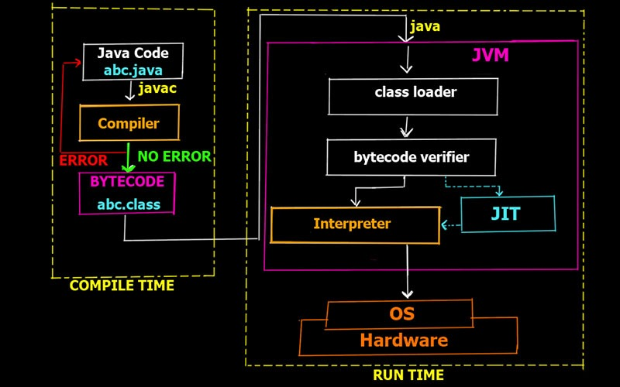
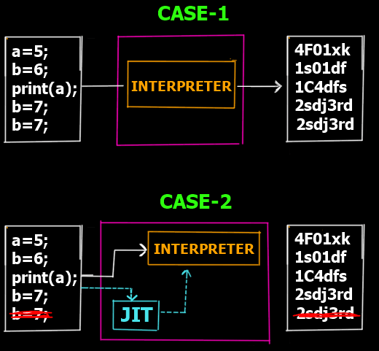
Overall Execution Process of Java Program

Slide 45
Compilation and execution of Java Program
Example
public class MyFirstJavaProgram
{
/* This is my first java program.
* This will print 'Hello World' as the output
*/
public static void main(String []args)
{
System.out.println("Hello World"); // prints Hello World
}
}

Slide 46
Let's look at how to save the file, compile, and run the program. Please follow the subsequent steps −
Open notepad and add the code as above.
Save the file as: MyFirstJavaProgram.java.
Open a command prompt window and go to the directory where you saved the class. Assume it's C:\.
Type 'javac MyFirstJavaProgram.java' and press enter to compile your code. If there are no errors in your code, the command prompt will take you to the next line (Assumption: The path variable is set).
Now, type ' java MyFirstJavaProgram ' to run your program.
You will be able to see ' Hello World ' printed on the window.

Slide 47
Basic Syntax
About Java programs, it is very important to keep in mind the following points.
Case Sensitivity − Java is case sensitive, which means identifier Hello and hello would have a different meaning in Java.
Class Names − For all class names, the first letter should be in Upper Case. If several words are used to form a name of the class, each inner word's first letter should be in Upper Case.
Example: class MyFirstJavaClass
Method Names − All method names should start with a Lower Case letter. If several words are used to form the name of the method, then each inner word's first letter should be in Upper Case.
Example: public void myMethodName()
Program File Name − Name of the program file should exactly match the class name.
When saving the file, you should save it using the class name (Remember Java is case sensitive) and append '.java' to the end of the name (if the file name and the class name do not match, your program will not compile).
Example: Assume 'MyFirstJavaProgram' is the class name. Then the file should be saved as 'MyFirstJavaProgram.java'
public static void main(String args[]) − Java program processing starts from the main() method which is a mandatory part of every Java program.

Slide 48
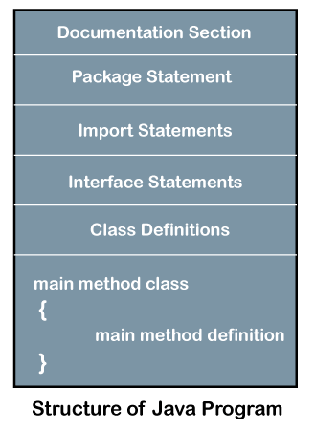
Structure of Java Program
Java is an object-oriented programming, platform-independent, and secure programming language that makes it popular. Using the Java programming language, we can develop a wide variety of applications.

Slide 49
Writing a “HELLO WORLD” Program in Java
// Basic java program
// to print "Hello World"
import java.io.*;
class GFG
{
public static void main(String[] args)
{
// prints Hello World
System.out.println("Hello World");
}
}
Output
Hello World

Slide 50
Explanation:
1. Comments: Comments are used for explaining code and are used in a similar manner in Java or C or C++. Compilers ignore the comment entries and do not execute them. Comments can be of a single line or multiple lines.
Single line Comments: Syntax:
// Single line commentMulti-line comments: Syntax:
/* Multi line comments*/2. import java.io.*: Means all the classes of io package can be imported. Java io package provides a set of input and output streams for reading and writing data to files or other input or output sources.
3. class: The class contains the data and methods to be used in the program. Methods define the behaviour of the class. Class GFG has only one method Main in JAVA.
4. static void Main(): static keyword tells us that this method is accessible without instantiating the class.
5. void: keywords tells that this method will not return anything. The main() method is the entry point of our application.
6. System.in: This is the standard input stream that is used to read characters from the keyboard or any other standard input device.
7. System.out: This is the standard output stream that is used to produce the result of a program on an output device like the computer screen.
8. println(): This method in Java is also used to display a text on the console. It prints the text on the console and the cursor moves to the start of the next line at the console. The next printing takes place from the next line.

Slide 51
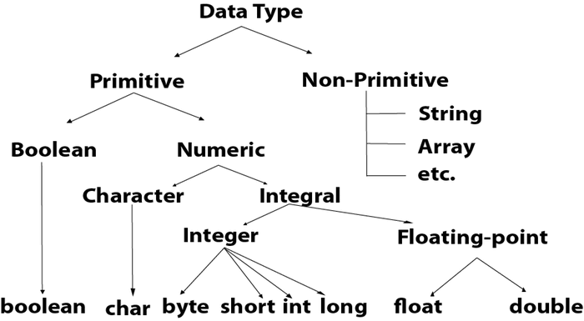
Data Types in Java
Data types specify the different sizes and values that can be stored in the variable. There are two types of data types in Java:
Primitive data types: The primitive data types include boolean, char, byte, short, int, long, float and double.
Non-primitive data types: The non-primitive data types include Classes, Interfaces, and Arrays.

Slide 52
Data Type | Size | Description
byte | 1 byte | Stores whole numbers from -128 to 127
short | 2 bytes | Stores whole numbers from -32,768 to 32,767
int | 4 bytes | Stores whole numbers from -2,147,483,648 to 2,147,483,647
long | 8 bytes | Stores whole numbers from -9,223,372,036,854,775,808 to 9,223,372,036,854,775,807
float | 4 bytes | Stores fractional numbers. Sufficient for storing 6 to 7 decimal digits
double | 8 bytes | Stores fractional numbers. Sufficient for storing 15 decimal digits
boolean | 1 bit | Stores true or false values
char | 2 bytes | Stores a single character/letter or ASCII values

Slide 53
Example
byte myNum = 100;
short myNum = 5000;
int myNum = 5; // Integer (whole number)
long myNum = 15000000000L;
float myFloatNum = 5.99f; // Floating point number
double myNum = 19.99d;
char myLetter = 'D'; // Character
boolean myBool = true; // Boolean
String myText = "Hello"; // String

Slide 54
Non-Primitive Data Types
Non-primitive data types are called reference types because they refer to objects.
The main difference between primitive and non-primitive data types are:
Primitive types are predefined (already defined) in Java. Non-primitive types are created by the programmer and is not defined by Java (except for String).
Non-primitive types can be used to call methods to perform certain operations, while primitive types cannot.
A primitive type has always a value, while non-primitive types can be null.
A primitive type starts with a lowercase letter, while non-primitive types starts with an uppercase letter.
The size of a primitive type depends on the data type, while non-primitive types have all the same size.

Slide 55
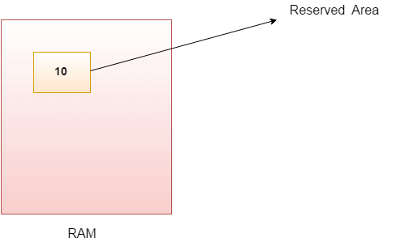
Java Variables
A variable is a container which holds the value while the Java program is executed. A variable is assigned with a data type.
Variable is a name of memory location. There are three types of variables in java: local, instance and static.
Variable is name of reserved area allocated in memory. In other words, it is a name of memory location. It is a combination of "vary + able" that means its value can be changed.

Slide 56
All Java variables must be identified with unique names.
These unique names are called identifiers.
Identifiers can be short names (like x and y) or more descriptive names (age, sum, totalVolume).
The general rules for constructing names for variables (unique identifiers) are:
Names can contain letters, digits, underscores, and dollar signs
Names must begin with a letter
Names should start with a lowercase letter and it cannot contain whitespace
Names can also begin with $ and _ (but we will not use it in this tutorial)
Names are case sensitive ("myVar" and "myvar" are different variables)
Reserved words (like Java keywords, such as int or boolean) cannot be used as names

Slide 57
Declaring (Creating) Variables
To create a variable, you must specify the type and assign it a value:
Syntax
type variable = value;
Where type is one of Java's types (such as int or String), and
variable is the name of the variable (such as x or name). The equal sign is used to assign values to the variable.

Slide 58
Types of Variables
There are three types of variables in Java:
local variable
instance variable
static variable
1) Local Variable
A variable declared inside the body of the method is called local variable. You can use this variable only within that method and the other methods in the class aren't even aware that the variable exists.
A local variable cannot be defined with "static" keyword.
2) Instance Variable
A variable declared inside the class but outside the body of the method, is called instance variable. It is not declared as static.
It is called instance variable because its value is instance specific and is not shared among instances.
3) Static variable
A variable which is declared as static is called static variable. It cannot be local. You can create a single copy of static variable and share among all the instances of the class. Memory allocation for static variable happens only once when the class is loaded in the memory.

Slide 59
Example to understand the types of variables in java
class A
{
int data=50; //instance variable
static int m=100; //static variable
void method(){
int n=90; //local variable
}
} //end of class

Slide 60
Operators
Operator in Java is a symbol which is used to perform operations. For example: +, -, *, / etc.
There are many types of operators in Java which are given below:
Unary Operator,
Arithmetic Operator,
Shift Operator,
Relational Operator,
Bitwise Operator,
Logical Operator,
Ternary Operator and
Assignment Operator

Slide 61
Java Operator Precedence
Operator Type | Category | Precedence
Unary | postfix | expr++ expr--
 | prefix | ++expr --expr +expr -expr ~ !
Arithmetic | multiplicative | * / %
 | additive | + -
Shift | shift | << >> >>>
Relational | comparison | < > <= >= instanceof
 | equality | == !=
Bitwise | bitwise AND | &
 | bitwise exclusive OR | ^
 | bitwise inclusive OR | |
Logical | logical AND | &&
 | logical OR | ||
Ternary | ternary | ? :
Assignment | assignment | = += -= *= /= %= &= ^= |= <<= >>= >>>=

Slide 62
Java Unary Operator
The Java unary operators require only one operand. Unary operators are used to perform various operations i.e.:
incrementing/decrementing a value by one
negating an expression
inverting the value of a boolean
Java Unary Operator Example: ++ and --
class OperatorExample{
public static void main(String args[]){
int x=10;
System.out.println(x++);//10 (11)
System.out.println(++x);//12
System.out.println(x--);//12 (11)
System.out.println(--x);//10
}}

Slide 63
Java Unary Operator Example: ~ and !
class OperatorExample{
public static void main(String args[]){
int a=10;
int b=-10;
boolean c=true;
boolean d=false;
System.out.println(~a);//-11 (minus of total positive value which starts from 0)
System.out.println(~b);//9 (positive of total minus, positive starts from 0)
System.out.println(!c);//false (opposite of boolean value)
System.out.println(!d);//true
}}

Slide 64
Java Arithmetic Operators
Java arithmatic operators are used to perform addition, subtraction, multiplication, and division. They act as basic mathematical operations.
Java Arithmetic Operator Example
class OperatorExample{
public static void main(String args[]){
int a=10;
int b=5;
System.out.println(a+b);//15
System.out.println(a-b);//5
System.out.println(a*b);//50
System.out.println(a/b);//2
System.out.println(a%b);//0
}}

Slide 65
Java Left Shift Operator
The Java left shift operator << is used to shift all of the bits in a value to the left side of a specified number of times.
Java Left Shift Operator Example
class OperatorExample{
public static void main(String args[]){
System.out.println(10<<2);//10*2^2=10*4=40
System.out.println(10<<3);//10*2^3=10*8=80
System.out.println(20<<2);//20*2^2=20*4=80
System.out.println(15<<4);//15*2^4=15*16=240
}}

Slide 66
Java Right Shift Operator
The Java right shift operator >> is used to move left operands value to right by the number of bits specified by the right operand.
Java Right Shift Operator Example
class OperatorExample{
public static void main(String args[]){
System.out.println(10>>2);//10/2^2=10/4=2
System.out.println(20>>2);//20/2^2=20/4=5
System.out.println(20>>3);//20/2^3=20/8=2
}}

Slide 67
Java Shift Operator Example: >> vs >>>
class OperatorExample{
public static void main(String args[]){
//For positive number, >> and >>> works same
System.out.println(20>>2);
System.out.println(20>>>2);
//For negative number, >>> changes parity bit (MSB) to 0
System.out.println(-20>>2);
System.out.println(-20>>>2);
}}

Slide 68
Java Ternary Operator
Java Ternary operator is used as one liner replacement for if-then-else statement and used a lot in Java programming. it is the only conditional operator which takes three operands.
Java Ternary Operator Example
class OperatorExample{
public static void main(String args[]){
int a=2;
int b=5;
int min=(a<b)?a:b;
System.out.println(min);
}}

Slide 69
Java Assignment Operator
Java assignment operator is one of the most common operator. It is used to assign the value on its right to the operand on its left.
Java Assignment Operator Example
class OperatorExample{
public static void main(String args[]){
int a=10;
int b=20;
a+=4;//a=a+4 (a=10+4)
b-=4;//b=b-4 (b=20-4)
System.out.println(a);
System.out.println(b);
}}

Slide 70
Java AND Operator Example: Logical && and Bitwise &
The logical && operator doesn't check second condition if first condition is false. It checks second condition only if first one is true.
The bitwise & operator always checks both conditions whether first condition is true or false.
class OperatorExample{
public static void main(String args[]){
int a=10;
int b=5;
int c=20;
System.out.println(a<b&&a<c);//false && true = false
System.out.println(a<b&a<c);//false & true = false
}}

Slide 71
Java OR Operator Example: Logical || and Bitwise |
The logical || operator doesn't check second condition if first condition is true. It checks second condition only if first one is false.
The bitwise | operator always checks both conditions whether first condition is true or false.
class OperatorExample{
public static void main(String args[]){
int a=10;
int b=5;
int c=20;
System.out.println(a>b||a<c);//true || true = true
System.out.println(a>b|a<c);//true | true = true
//|| vs |
System.out.println(a>b||a++<c);//true || true = true
System.out.println(a);//10 because second condition is not checked
System.out.println(a>b|a++<c);//true | true = true
System.out.println(a);//11 because second condition is checked
}}

Slide 72
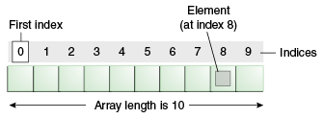
Arrays
An array is a collection of similar type of elements which has contiguous memory location.
Java array is an object which contains elements of a similar data type. Additionally, The elements of an array are stored in a contiguous memory location.
It is a data structure where we store similar elements. We can store only a fixed set of elements in a Java array.
Array in Java is index-based, the first element of the array is stored at the 0th index, 2nd element is stored on 1st index and so on.
Advantages
Code Optimization: It makes the code optimized, we can retrieve or sort the data efficiently.
Random access: We can get any data located at an index position.
Disadvantages
Size Limit: We can store only the fixed size of elements in the array. It doesn't grow its size at runtime. To solve this problem, collection framework is used in Java which grows automatically.

Slide 73
Types of Array in java
There are two types of array.
Single Dimensional Array
Multidimensional Array
Single Dimensional Array in Java
Syntax to Declare an Array in Java
dataType[] arr; (or)
dataType []arr; (or)
dataType arr[];
Instantiation of an Array in Java
arrayRefVar=new datatype[size];

Slide 74
Declaration, Instantiation and Initialization of Java Array
We can declare, instantiate and initialize the java array together by:
int a[]={33,3,4,5};//declaration, instantiation and initialization
Example
class Testarray1{
public static void main(String args[]){
int a[]={33,3,4,5};//declaration, instantiation and initialization
//printing array
for(int i=0;i<a.length;i++)//length is the property of array
System.out.println(a[i]);
}}

Slide 75
Access the Elements of an Array
You access an array element by referring to the index number.
This statement accesses the value of the first element in cars:
Example
String[] cars = {"Volvo", "BMW", "Ford", "Mazda"}; System.out.println(cars[0]);
// Outputs Volvo
Change an Array Element
To change the value of a specific element, refer to the index number:
Example
cars[0] = "Opel";
Array Length
To find out how many elements an array has, use the length property:
Example
String[] cars = {"Volvo", "BMW", "Ford", "Mazda"}; System.out.println(cars.length); // Outputs 4

Slide 76
Loop Through an Array
You can loop through the array elements with the for loop, and use the length property to specify how many times the loop should run.
The following example outputs all elements in the cars array:
Example
String[] cars = {"Volvo", "BMW", "Ford", "Mazda"}; for (int i = 0; i < cars.length; i++) { System.out.println(cars[i]); }
Loop Through an Array with For-Each
There is also a "for-each" loop, which is used exclusively to loop through elements in arrays:
Syntax
for (type variable : arrayname) { ... }
Example
String[] cars = {"Volvo", "BMW", "Ford", "Mazda"}; for (String i : cars) { System.out.println(i); }

Slide 77
Example of Java Array
Let's see the simple example of java array, where we are going to declare, instantiate, initialize and traverse an array.
//Java Program to illustrate how to declare, instantiate, initialize
//and traverse the Java array.
class Testarray{
public static void main(String args[]){
int a[]=new int[5];//declaration and instantiation
a[0]=10;//initialization
a[1]=20;
a[2]=70;
a[3]=40;
a[4]=50;
//traversing array
for(int i=0;i<a.length;i++)//length is the property of array
System.out.println(a[i]);
}}

Slide 78
Passing Array to a Method in Java
We can pass the java array to method so that we can reuse the same logic on any array.
Let's see the simple example to get the minimum number of an array using a method.
class Testarray2{
//creating a method which receives an array as a parameter
static void min(int arr[]){
int min=arr[0];
for(int i=1;i<arr.length;i++)
if(min>arr[i])
min=arr[i];
System.out.println(min);
}
public static void main(String args[]){
int a[]={33,3,4,5};//declaring and initializing an array
min(a);//passing array to method
}}

Slide 79
Multidimensional Arrays
A multidimensional array is an array containing one or more arrays.
Syntax to Declare Multidimensional Array in Java
dataType[][] arrayRefVar; (or)
dataType [][]arrayRefVar; (or)
dataType arrayRefVar[][]; (or)
dataType []arrayRefVar[];
Example to instantiate Multidimensional Array in Java
int[][] arr=new int[2][2];//2 row and 2 column
Example to initialize Multidimensional Array in Java
arr[0][0]=1;
arr[0][1]=2;
arr[1][0]=4;
arr[1][1]=5;

Slide 80
Example of Multidimensional Java Array
//Java Program to demonstrate the addition of two matrices in Java
class Testarray5{
public static void main(String args[]){
//creating two matrices
int a[][]={{1,3,4},{3,4,5}};
int b[][]={{1,3,4},{3,4,5}};
//creating another matrix to store the sum of two matrices
int c[][]=new int[2][3];
//adding and printing addition of 2 matrices
for(int i=0;i<2;i++){
for(int j=0;j<3;j++){
c[i][j]=a[i][j]+b[i][j];
System.out.print(c[i][j]+" ");
}
System.out.println();//new line
}
}}

Slide 81
Control statements
If-else: Executes code based on a true/false condition.
Switch: Selects one of many code blocks based on a value (often int, char, String).
Loops: for, while, and do-while are used to repeat a block of code multiple times until a condition is met.

Slide 82
Selection or Decision-Making Statements
Statements that determine which statement to execute and when are known as decision-making statements. The flow of the execution of the program is controlled by the control flow statement.
There are four decision-making statements available in java.
Simple if statement
if-else statement
Nested if statement
Switch statement

Slide 83
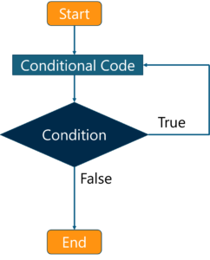
Control statements
A control statement in java is a statement that determines whether the other statements will be executed or not. It controls the flow of a program. An ‘if’ statement in java determines the sequence of execution between a set of two statements.
Control Statements can be divided into three categories, namely
Selection statements
Iteration statements
Jump statements

Slide 84
Simple if statement
if statement is the most simple decision making statement. It is used to decide whether a certain statement or block of statements will be executed or not i.e if a certain condition is true then a block of statement is executed otherwise not.
Syntax:
if(condition)
{
// Statements to execute if condition is true
}
Here, condition after evaluation will be either true or false. if statement accepts boolean values – if the value is true then it will execute the block of statements under it. If we do not provide the curly braces ‘{‘ and ‘}’ after if( condition ) then by default if statement will consider the immediate one statement to be inside its block. For example,
if(condition)
statement1;
statement2;
// Here if the condition is true, if block will consider only statement1 to be inside its block.

Slide 85
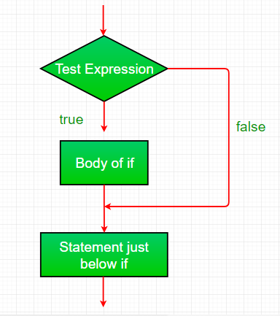
Example:
// Java program to illustrate If statement
class IfDemo
{
public static void main(String args[])
{
int i = 10;
if (i > 15)
System.out.println("10 is less than 15");
// This statement will be executed
// as if considers one statement by default
System.out.println("I am Not in if");
}
}

Slide 86
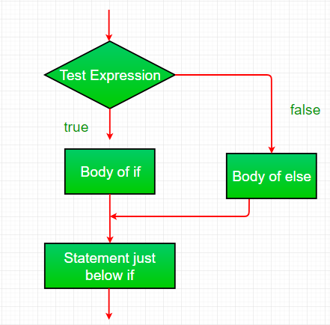
if-else
The if statement alone tells us that if a condition is true it will execute a block of statements and if the condition is false it won’t. But what if we want to do something else if the condition is false. Here comes the else statement. We can use the else statement with if statement to execute a block of code when the condition is false.
Syntax:
if (condition)
{ // Executes this block if // condition is true }
else
{ // Executes this block if // condition is false }

Slide 87
Example:
// Java program to illustrate if-else statement
class IfElseDemo
{
public static void main(String args[])
{
int i = 10;
if (i < 15)
System.out.println("i is smaller than 15");
else
System.out.println("i is greater than 15");
}
}
Output:
i is smaller than 15

Slide 88
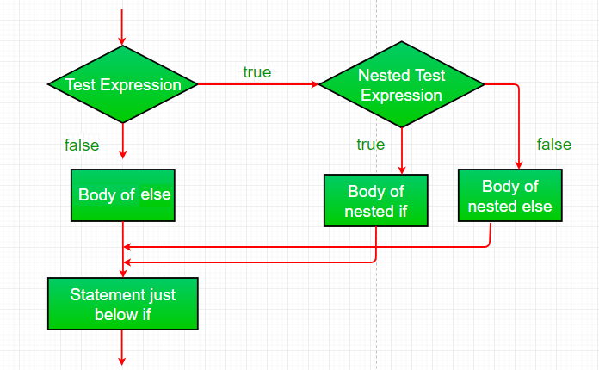
nested-if:
A nested if is an if statement that is the target of another if or else. Nested if statements means an if statement inside an if statement. Yes, java allows us to nest if statements within if statements. i.e, we can place an if statement inside another if statement.
Syntax:
if (condition1)
{
// Executes when condition1 is true
if (condition2)
{
// Executes when condition2 is true
}
}

Slide 89
Example:
// Java program to illustrate nested-if statement
class NestedIfDemo
{
public static void main(String args[]) {
int i = 10;
if (i == 10)
{
if (i < 15)
System.out.println("i is smaller than 15");
if (i < 12)
System.out.println("i is smaller than 12 too");
else
System.out.println("i is greater than 15");
}
}
}

Slide 90
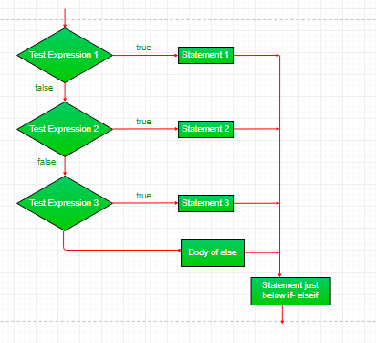
if-else-if ladder:
Here, a user can decide among multiple options.The if statements are executed from the top down. As soon as one of the conditions controlling the if is true, the statement associated with that if is executed, and the rest of the ladder is bypassed. If none of the conditions is true, then the final else statement will be executed.
Synatax:
if (condition)
statement;
else if (condition)
statement;
.
.
else statement;

Slide 91
Example:
// Java program to illustrate if-else-if ladder
class ifelseifDemo
{
public static void main(String args[])
{
int i = 20;
if (i == 10)
System.out.println("i is 10");
else if (i == 15)
System.out.println("i is 15");
else if (i == 20)
System.out.println("i is 20");
else
System.out.println("i is not present");
}
}

Slide 92
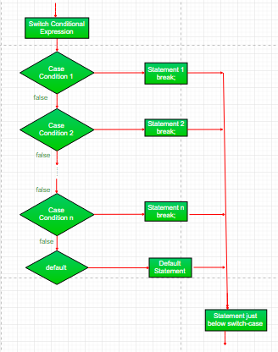
switch-case
The switch statement is a multiway branch statement. It provides an easy way to dispatch execution to different parts of code based on the value of the expression.
Syntax:
switch (expression)
{
case value1:
statement1;
break;
case value2:
statement2;
break;
. .
case valueN:
statementN;
break;
default:
statementDefault;
}

Slide 93
Expression can be of type byte, short, int char or an enumeration. Beginning with JDK7, expression can also be of type String.
Duplicate case values are not allowed.
The default statement is optional.
The break statement is used inside the switch to terminate a statement sequence.
The break statement is optional. If omitted, execution will continue on into the next case.

Slide 94
Example:
// Java program to illustrate switch-case
class SwitchCaseDemo
{
public static void main(String args[])
{
int i = 9;
switch (i)
{
case 0:
System.out.println("i is zero.");
break;
case 1:
System.out.println("i is one.");
break;
default:
System.out.println("i is greater than 2.");
}
}
}

Slide 95
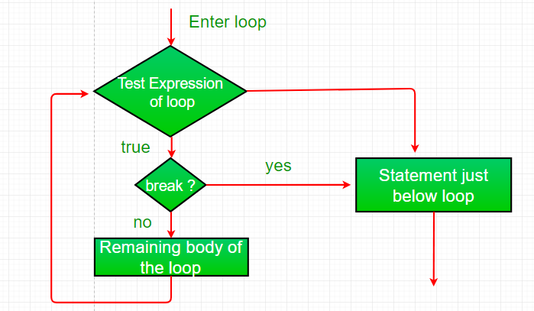
Jump Statements
Java supports three jump statement: break, continue and return.
These three statements transfer control to other part of the program.
Break: In Java, break is majorly used for:
Terminate a sequence in a switch statement
To exit a loop.
Used as a “civilized” form of goto.
Using break to exit a Loop
Using break, we can force immediate termination of a loop, bypassing the conditional expression and any remaining code in the body of the loop. Note: Break, when used inside a set of nested loops, will only break out of the innermost loop.

Slide 96
Example:
// Java program to illustrate using
// break to exit a loop
class BreakLoopDemo
{
public static void main(String args[])
{
// Initially loop is set to run from 0-9
for (int i = 0; i < 10; i++)
{
// terminate loop when i is 5.
if (i == 5)
break;
System.out.println("i: " + i);
}
System.out.println("Loop complete.");
}
}

Slide 97
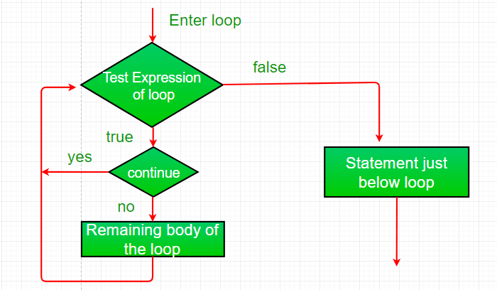
Continue:
Sometimes it is useful to force an early iteration of a loop. That is, you might want to continue running the loop but stop processing the remainder of the code in its body for this particular iteration.
This is, in effect, a goto just past the body of the loop, to the loop’s end.
The continue statement performs such an action.

Slide 98
Example:
class ContinueDemo
{
public static void main(String args[])
{
for (int i = 0; i < 10; i++)
{
// If the number is even
// skip and continue
if (i%2 == 0)
continue;
// If number is odd, print it
System.out.print(i + " ");
}
}
}

Slide 99
Return
The return statement is used to explicitly return from a method. That is, it causes a program control to transfer back to the caller of the method.
Example:
class Return
{
public static void main(String args[])
{
boolean t = true;
System.out.println("Before the return.");
if (t)
return;
// Compiler will bypass every statement
// after return
System.out.println("This won't execute.");
}
}

Slide 100
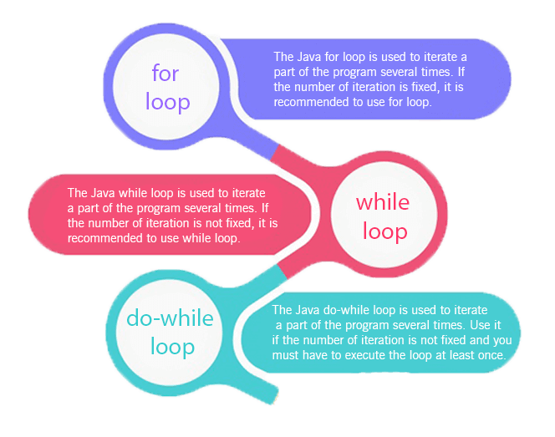
Loops in Java
In programming languages, loops are used to execute a set of instructions/functions repeatedly when some conditions become true. There are three types of loops in Java.
for loop
while loop
do-while loop

Slide 101
Java For Loop vs While Loop vs Do While Loop
Comparison | for loop | while loop | do while loop
Introduction | The Java for loop is a control flow statement that iterates a part of the programs multiple times. | The Java while loop is a control flow statement that executes a part of the programs repeatedly on the basis of given boolean condition. | The Java do while loop is a control flow statement that executes a part of the programs at least once and the further execution depends upon the given boolean condition.
When to use | If the number of iteration is fixed, it is recommended to use for loop. | If the number of iteration is not fixed, it is recommended to use while loop. | If the number of iteration is not fixed and you must have to execute the loop at least once, it is recommended to use the do-while loop.
Syntax | for(init;condition;incr/decr){ // code to be executed } | while(condition){ //code to be executed } | do{ //code to be executed }while(condition);
Example | //for loop for(int i=1;i<=10;i++){ System.out.println(i); } | //while loop int i=1; while(i<=10){ System.out.println(i); i++; } | //do-while loop int i=1; do{ System.out.println(i); i++; }while(i<=10);
Syntax for infinitive loop | for(;;){ //code to be executed } | while(true){ //code to be executed } | do{ //code to be executed }while(true);

Slide 102
Java For Loop
The Java for loop is used to iterate a part of the program several times. If the number of iteration is fixed, it is recommended to use for loop.
There are three types of for loops in java.
Simple For Loop
For-each or Enhanced For Loop
Labeled For Loop
Java Simple For Loop
A simple for loop is the same as C/C++. We can initialize the variable, check condition and increment/decrement value. It consists of four parts:
Initialization: It is the initial condition which is executed once when the loop starts. Here, we can initialize the variable, or we can use an already initialized variable. It is an optional condition.
Condition: It is the second condition which is executed each time to test the condition of the loop. It continues execution until the condition is false. It must return boolean value either true or false. It is an optional condition.
Statement: The statement of the loop is executed each time until the second condition is false.
Increment/Decrement: It increments or decrements the variable value. It is an optional condition.

Slide 103
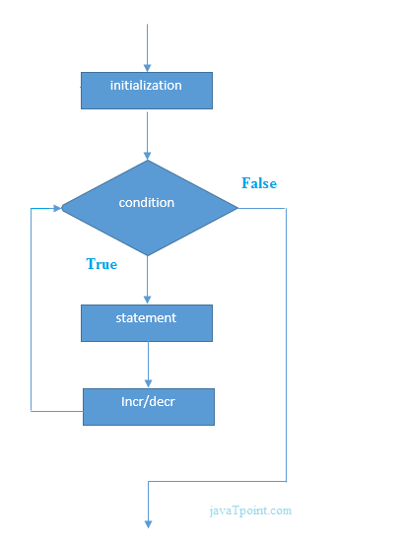
Syntax:
for(initialization; condition; incr/decr)
{
//statement or code to be executed
}

Slide 104
Example:
//Java Program to demonstrate the example of for loop
//which prints table of 1
public class ForExample {
public static void main(String[] args) {
//Code of Java for loop
for(int i=1;i<=10;i++){
System.out.println(i);
}
}
}

Slide 105
Java Nested For Loop
If we have a for loop inside the another loop, it is known as nested for loop. The inner loop executes completely whenever outer loop executes.
Example:
public class NestedForExample {
public static void main(String[] args) {
//loop of i
for(int i=1;i<=3;i++){
//loop of j
for(int j=1;j<=3;j++){
System.out.println(i+" "+j);
}//end of i
}//end of j
}
}

Slide 106
Java for-each Loop
The for-each loop is used to traverse array or collection in java. It is easier to use than simple for loop because we don't need to increment value and use subscript notation.
It works on elements basis not index. It returns element one by one in the defined variable.
Syntax:
for(Type var:array){
//code to be executed
}

Slide 107
Example:
//Java For-each loop example which prints the
//elements of the array
public class ForEachExample {
public static void main(String[] args) {
//Declaring an array
int arr[]={12,23,44,56,78};
//Printing array using for-each loop
for(int i:arr){
System.out.println(i);
}
}
}

Slide 108
Java Labeled For Loop
We can have a name of each Java for loop. To do so, we use label before the for loop. It is useful if we have nested for loop so that we can break/continue specific for loop.
Usually, break and continue keywords breaks/continues the innermost for loop only.
Syntax:
labelname:
for(initialization;condition;incr/decr){
//code to be executed
}

Slide 109
Example:
//A Java program to demonstrate the use of labeled for loop
public class LabeledForExample {
public static void main(String[] args) {
//Using Label for outer and for loop
aa:
for(int i=1;i<=3;i++){
bb:
for(int j=1;j<=3;j++){
if(i==2&&j==2){
break aa;
}
System.out.println(i+" "+j);
}
}
}
}

Slide 110
Java Infinitive For Loop
If you use two semicolons ;; in the for loop, it will be infinitive for loop.
Syntax:
for(;;){
//code to be executed
}
Example:
//Java program to demonstrate the use of infinite for loop
//which prints an statement
public class ForExample {
public static void main(String[] args) {
//Using no condition in for loop
for(;;){
System.out.println("infinitive loop");
}
}
}
you need to press ctrl+c to exit from the program.

Slide 111
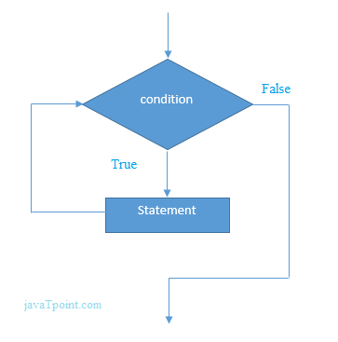
Java While Loop
The Java while loop is used to iterate a part of the program several times. If the number of iteration is not fixed, it is recommended to use while loop.
Syntax:
while(condition)
{
//code to be executed
}

Slide 112
Example:
public class WhileExample {
public static void main(String[] args) {
int i=1;
while(i<=10){
System.out.println(i);
i++;
}
}
}

Slide 113
Java Infinitive While Loop
If you pass true in the while loop, it will be infinitive while loop.
Syntax:
while(true){
//code to be executed
}
Example:
public class WhileExample2 {
public static void main(String[] args) {
while(true){
System.out.println("infinitive while loop");
}
}
}

Slide 114
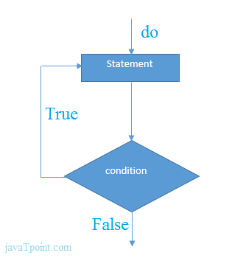
Java do-while Loop
The Java do-while loop is used to iterate a part of the program several times. If the number of iteration is not fixed and you must have to execute the loop at least once, it is recommended to use do-while loop.
The Java do-while loop is executed at least once because condition is checked after loop body.
Syntax:
do{
//code to be executed
}while(condition);

Slide 115
Example:
public class DoWhileExample {
public static void main(String[] args) {
int i=1;
do{
System.out.println(i);
i++;
}while(i<=10);
}
}

Slide 116
Java Infinitive do-while Loop
If you pass true in the do-while loop, it will be infinitive do-while loop.
Syntax:
do{
//code to be executed
}while(true);
Example:
public class DoWhileExample2 {
public static void main(String[] args) {
do{
System.out.println("infinitive do while loop");
}while(true);
}
}

Slide 117
Type Conversion and Casting
When you assign value of one data type to another, the two types might not be compatible with each other.
If the data types are compatible, then Java will perform the conversion automatically known as Automatic Type Conversion and if not then they need to be casted or converted explicitly. For example, assigning an int value to a long variable.
In Java, there are two types of casting:
Widening Casting (automatically) - converting a smaller type to a larger type size byte -> short -> char -> int -> long -> float -> double Narrowing Casting (manually) - converting a larger type to a smaller size type double -> float -> long -> int -> char -> short -> byte

Slide 118
Widening Casting
Widening casting is done automatically when passing a smaller size type to a larger size type:
Example
public class Main
{
public static void main(String[] args)
{
int myInt = 9;
double myDouble = myInt; // Automatic casting: int to double
System.out.println(myInt); // Outputs 9
System.out.println(myDouble); // Outputs 9.0
}
}

Slide 119
Narrowing Casting
Narrowing casting must be done manually by placing the type in parentheses in front of the value:
Example
public class Main
{
public static void main(String[] args)
{
double myDouble = 9.78;
int myInt = (int) myDouble; // Manual casting: double to int
System.out.println(myDouble); // Outputs 9.78
System.out.println(myInt); // Outputs 9
}
}

Slide 120
Difference Between Type Casting and Type Conversion
S.N | Type Casting | Type Conversion
1 | Type casting is a mechanism in which one data type is converted to another data type using a casting () operator by a programmer. | Type conversion allows a compiler to convert one data type to another data type at the compile time of a program or code.
2 | It can be used both compatible data type and incompatible data type. | Type conversion is only used with compatible data types, and hence it does not require any casting operator.
3 | It requires a programmer to manually casting one data into another type. | It does not require any programmer intervention to convert one data type to another because the compiler automatically compiles it at the run time of a program.
4 | It is used while designing a program by the programmer. | It is used or take place at the compile time of a program.
5 | When casting one data type to another, the destination data type must be smaller than the source data. | When converting one data type to another, the destination type should be greater than the source data type.
6 | It is also known as narrowing conversion because one larger data type converts to a smaller data type. | It is also known as widening conversion because one smaller data type converts to a larger data type.
7 | It is more reliable and efficient. | It is less efficient and less reliable.
8 | There is a possibility of data or information being lost in type casting. | In type conversion, data is unlikely to be lost when converting from a small to a large data type.
8 | float b = 3.0; int a = (int) b | int x = 5, y = 2, c; float q = 12.5, p; p = q/x;

Slide 121
Concepts of classes and objects: Basic Concepts of OOPs – Constructors - Static keyword - Final with data - Access control - This key word - Garbage collection - Nested classes and inner classes - String class.

Slide 122
Introduction of Object Oriented Programming
Object-Oriented Programming or OOPs refers to languages that use objects in programming.
Object-oriented programming aims to implement real-world entities like inheritance, hiding, polymorphism, etc in programming.
The main aim of OOP is to bind together the data and the functions that operate on them so that no other part of the code can access this data except that function.

Slide 123
OOPs Concepts:
Class
Objects
Data Abstraction
Encapsulation
Inheritance
Polymorphism
Dynamic Binding
Message Passing

Slide 124
1. Class:
A class is a user-defined data type. It consists of data members and member functions, which can be accessed and used by creating an instance of that class.
It represents the set of properties or methods that are common to all objects of one type. A class is like a blueprint for an object.
For Example:
Consider the Class of Cars.
There may be many cars with different names and brands but all of them will share some common properties like all of them will have 4 wheels, Speed Limit, Mileage range, etc. So here, Car is the class, and wheels, speed limits, mileage are their properties.

Slide 125
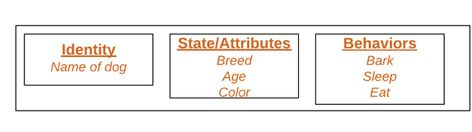
2. Object:
It is a basic unit of Object-Oriented Programming and represents the real-life entities.
An Object is an instance of a Class. When a class is defined, no memory is allocated but when it is instantiated (i.e. an object is created) memory is allocated.
An object has an identity, state, and behavior. Each object contains data and code to manipulate the data. Objects can interact without having to know details of each other’s data or code, it is sufficient to know the type of message accepted and type of response returned by the objects.
For example “Dog” is a real-life Object, which has some characteristics like color, Breed, Bark, Sleep, and Eats.

Slide 126
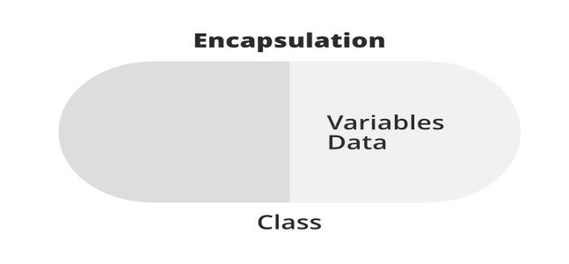
3. Data Abstraction & Encapsulation:
Data abstraction is one of the most essential and important features of object-oriented programming. Data abstraction refers to providing only essential information about the data to the outside world, hiding the background details or implementation.
Consider a real-life example of a man driving a car. The man only knows that pressing the accelerators will increase the speed of the car or applying brakes will stop the car, but he does not know about how on pressing the accelerator the speed is increasing, he does not know about the inner mechanism of the car or the implementation of the accelerator, brakes, etc in the car. This is what abstraction is.
Encapsulation is defined as the wrapping up of data under a single unit. It is the mechanism that binds together code and the data it manipulates.
In Encapsulation, the variables or data of a class are hidden from any other class and can be accessed only through any member function of their class in which they are declared.
As in encapsulation, the data in a class is hidden from other classes, so it is also known as data-hiding.

Slide 127
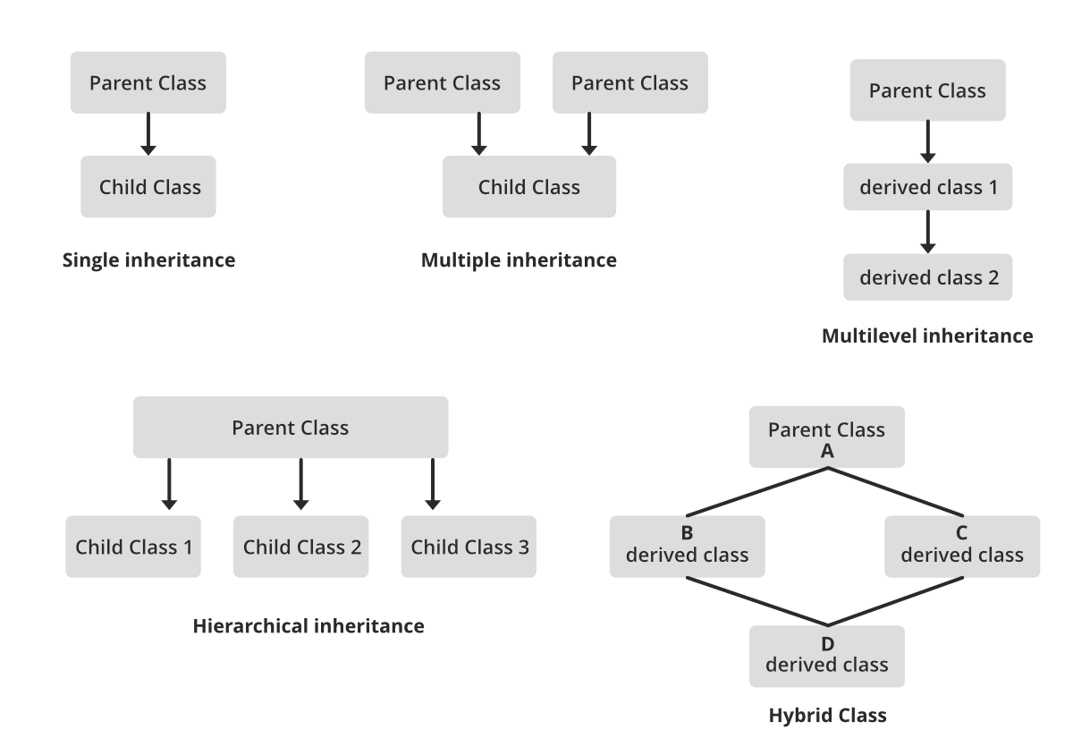
4. Inheritance:
Inheritance is an important pillar of OOP(Object-Oriented Programming). The capability of a class to derive properties and characteristics from another class is called Inheritance.
When we write a class, we inherit properties from other classes. So when we create a class, we do not need to write all the properties and functions again and again, as these can be inherited from another class that possesses it.
Inheritance allows the user to reuse the code whenever possible and reduce its redundancy.

Slide 128
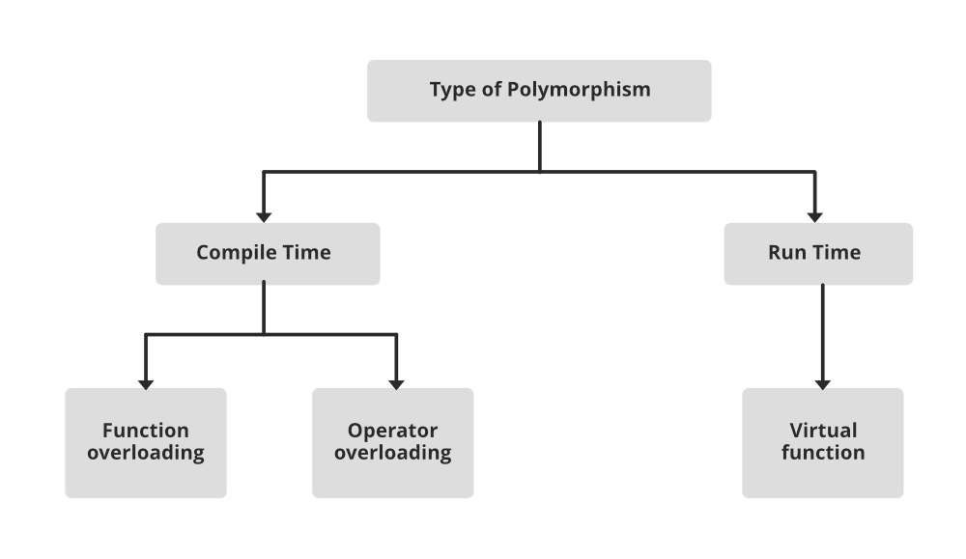
5. Polymorphism:
The word polymorphism means having many forms. In simple words, we can define polymorphism as the ability of a message to be displayed in more than one form.
For example, A person at the same time can have different characteristics. Like a man at the same time is a father, a husband, an employee. So the same person posses different behavior in different situations. This is called polymorphism.

Slide 129
6. Dynamic Binding:
In dynamic binding, the code to be executed in response to the function call is decided at runtime.
Dynamic binding means that the code associated with a given procedure call is not known until the time of the call at run time.
Dynamic Method Binding One of the main advantages of inheritance is that some derived class D has all the members of its base class B. Once D is not hiding any of the public members of B, then an object of D can represent B in any context where a B could be used. This feature is known as subtype polymorphism.

Slide 130
7. Message Passing:
It is a form of communication used in object-oriented programming as well as parallel programming. Objects communicate with one another by sending and receiving information to each other.
A message for an object is a request for execution of a procedure and therefore will invoke a function in the receiving object that generates the desired results.
Message passing involves specifying the name of the object, the name of the function, and the information to be sent.

Slide 131
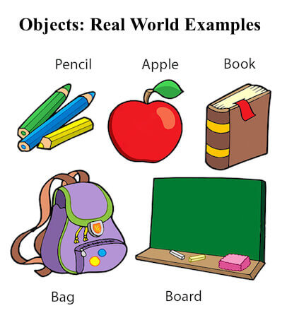
Concepts of Class and Object
What is an object in Java
An entity that has state and behavior is known as an object e.g., chair, bike, marker, pen, table, car, etc. It can be physical or logical (tangible and intangible). The example of an intangible object is the banking system.

Slide 132
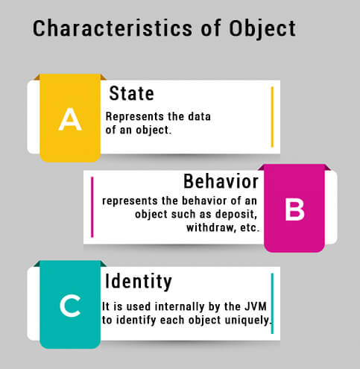
An object has three characteristics:
State: represents the data (value) of an object.
Behavior: represents the behavior (functionality) of an object such as deposit, withdraw, etc.
Identity: An object identity is typically implemented via a unique ID. The value of the ID is not visible to the external user. However, it is used internally by the JVM to identify each object uniquely.

Slide 133
For Example, Pen is an object. Its name is Reynolds; color is white, known as its state. It is used to write, so writing is its behavior.
An object is an instance of a class. A class is a template or blueprint from which objects are created. So, an object is the instance(result) of a class.
Object Definitions:
An object is a real-world entity.
An object is a runtime entity.
The object is an entity which has state and behavior.
The object is an instance of a class.

Slide 134
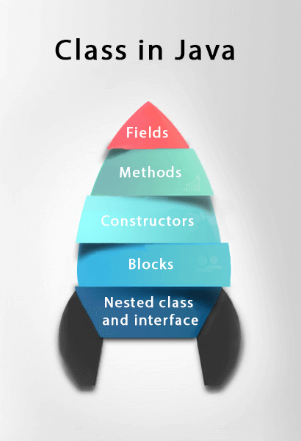
What is a class in Java
A class is a group of objects which have common properties. It is a template or blueprint from which objects are created. It is a logical entity. It can't be physical.
A class in Java can contain:
Fields
Methods
Constructors
Blocks
Nested class and interface

Slide 135
Syntax to declare a class:
class <class_name>
{
field;
method;
}
Instance variable in Java
A variable which is created inside the class but outside the method is known as an instance variable. Instance variable doesn't get memory at compile time. It gets memory at runtime when an object or instance is created. That is why it is known as an instance variable.
Method in Java
In Java, a method is like a function which is used to expose the behavior of an object.
Advantage of Method
Code Reusability
Code Optimization
New Keyword
The new keyword is used to allocate memory at runtime. All objects get memory in Heap memory area.

Slide 136
Object and Class Example: main within the class
In this example, we have created a Student class which has two data members id and name. We are creating the object of the Student class by new keyword and printing the object's value.
File: Student.java
//Defining a Student class.
class Student{
//defining fields
int id;//field or data member or instance variable
String name;
//creating main method inside the Student class
public static void main(String args[]) {
//Creating an object or instance
Student s1=new Student();//creating an object of Student
//Printing values of the object
System.out.println(s1.id); //accessing member through reference variable
System.out.println(s1.name);
}
}

Slide 137
Object and Class Example: main outside the class
In real time development, we create classes and use it from another class. It is a better approach than previous one. Let's see a simple example, where we are having main() method in another class.
We can have multiple classes in different Java files or single Java file. If you define multiple classes in a single Java source file, it is a good idea to save the file name with the class name which has main() method.

Slide 138
File: TestStudent1.java
//Java Program to demonstrate having the main method in
//another class
//Creating Student class.
class Student{
int id;
String name;
}
//Creating another class TestStudent1 which contains the main method
class TestStudent1{
public static void main(String args[]){
Student s1=new Student();
System.out.println(s1.id);
System.out.println(s1.name);
}
}

Slide 139
3 Ways to initialize object
There are 3 ways to initialize object in Java.
By reference variable
By method
By constructor

Slide 140
1) Object and Class Example: Initialization through reference
Initializing an object means storing data into the object. Let's see a simple example where we are going to initialize the object through a reference variable.
File: TestStudent2.java
class Student
{
int id;
String name;
}
class TestStudent2{
public static void main(String args[]){
Student s1=new Student();
s1.id=101;
s1.name="Sonoo";
System.out.println(s1.id+" "+s1.name);//printing members with a white space
}
}

Slide 141
2) Object and Class Example: Initialization through method
In this example, we are creating the two objects of Student class and initializing the value to these objects by invoking the insertRecord method. Here, we are displaying the state (data) of the objects by invoking the displayInformation() method.
File: TestStudent4.java
class Student{
int rollno;
String name;
void insertRecord(int r, String n){
rollno=r;
name=n;
}
void displayInformation(){System.out.println(rollno+" "+name);}
}
class TestStudent4{
public static void main(String args[]){
Student s1=new Student();
Student s2=new Student();
s1.insertRecord(111,"Karan");
s2.insertRecord(222,"Aryan");
s1.displayInformation();
s2.displayInformation();
}
}

Slide 142
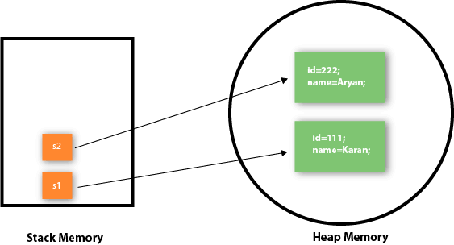
As you can see in the above figure, object gets the memory in heap memory area. The reference variable refers to the object allocated in the heap memory area. Here, s1 and s2 both are reference variables that refer to the objects allocated in memory.

Slide 143
3) Object and Class Example: Initialization through a constructor
Object and Class Example: Employee
File: TestEmployee.java
class Employee{
int id;
String name;
float salary;
void insert(int i, String n, float s) {
id=i;
name=n;
salary=s;
}
void display(){System.out.println(id+" "+name+" "+salary);}
}
public class TestEmployee {
public static void main(String[] args) {
Employee e1=new Employee();
Employee e2=new Employee();
Employee e3=new Employee();
e1.insert(101,"ajeet",45000);
e2.insert(102,"irfan",25000);
e3.insert(103,"nakul",55000);
e1.display();
e2.display();
e3.display();
}
}

Slide 144
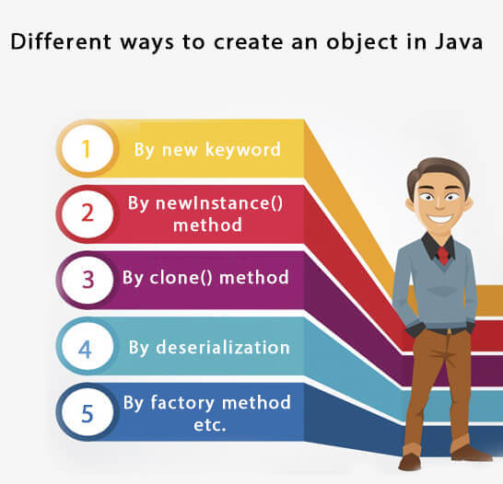
What are the different ways to create an object in Java?
There are many ways to create an object in java. They are:
By new keyword
By newInstance() method
By clone() method
By deserialization
By factory method etc.

Slide 145
Real World Example: Account
File: TestAccount.java
//Java Program to demonstrate the working of a banking-system
class Account{
int acc_no;
String name;
float amount;
void insert(int a,String n,float amt){
acc_no=a;
name=n;
amount=amt;
}
void deposit(float amt){
amount=amount+amt;
System.out.println(amt+" deposited");
}
void withdraw(float amt){
if(amount<amt){
System.out.println("Insufficient Balance");
}else{
amount=amount-amt;
System.out.println(amt+" withdrawn");
}
}
void checkBalance(){System.out.println("Balance is: "+amount);}
void display(){System.out.println(acc_no+" "+name+" "+amount);}
}
//Creating a test class to deposit and withdraw amount
class TestAccount{
public static void main(String[] args){
Account a1=new Account();
a1.insert(832345,"Ankit",1000);
a1.display();
a1.checkBalance();
a1.deposit(40000);
a1.checkBalance();
a1.withdraw(15000);
a1.checkBalance();
}}

Slide 146
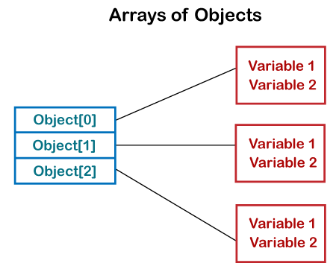
Array of Objects in Java
Java is an object-oriented programming language. Most of the work done with the help of objects.
We know that an array is a collection of the same data type that dynamically creates objects and can have elements of primitive types.
Java allows us to store objects in an array. In Java, the class is also a user-defined data type.
An array that conations class type elements are known as an array of objects. It stores the reference variable of the object.

Slide 147
ArrayOfObjects.java
public class ArrayOfObjects
{
public static void main(String args[])
{
//create an array of product object
Product[] obj = new Product[5] ;
//create & initialize actual product objects using constructor
obj[0] = new Product(23907,"Dell Laptop");
obj[1] = new Product(91240,"HP 630");
obj[2] = new Product(29823,"LG OLED TV");
obj[3] = new Product(11908,"MI Note Pro Max 9");
obj[4] = new Product(43590,"Kingston USB");
//display the product object data
System.out.println("Product Object 1:");
obj[0].display();
System.out.println("Product Object 2:");
obj[1].display();
System.out.println("Product Object 3:");
obj[2].display();
System.out.println("Product Object 4:");
obj[3].display();
System.out.println("Product Object 5:");
obj[4].display();
}
}
//Product class with product Id and product name as attributes
class Product
{
int pro_Id;
String pro_name;
//Product class constructor
Product(int pid, String n)
{
pro_Id = pid;
pro_name = n;
}
public void display()
{
System.out.print("Product Id = "+pro_Id + " " + " Product Name = "+pro_name);
System.out.println();
}
}

Slide 148
Constructor
In Java, a constructor is a block of codes similar to the method. It is called when an instance of the class is created. At the time of calling constructor, memory for the object is allocated in the memory.
It is a special type of method which is used to initialize the object.
Every time an object is created using the new() keyword, at least one constructor is called.
It calls a default constructor if there is no constructor available in the class. In such case, Java compiler provides a default constructor by default.
There are two types of constructors in Java: no-arg constructor, and parameterized constructor.
Note: It is called constructor because it constructs the values at the time of object creation. It is not necessary to write a constructor for a class. It is because java compiler creates a default constructor if your class doesn't have any.

Slide 149
Rules for creating Java constructor
There are two rules defined for the constructor.
Constructor name must be the same as its class name
A Constructor must have no explicit return type
A Java constructor cannot be abstract, static, final, and synchronized
Types of Java constructors
There are two types of constructors in Java:
Default constructor (no-arg constructor)
Parameterized constructor

Slide 150
Java Default Constructor
A constructor is called "Default Constructor" when it doesn't have any parameter.
Syntax of default constructor:
<class_name>()
{
}

Slide 151
Example of default constructor
//Java Program to create and call a default constructor
class Bike1{
//creating a default constructor
Bike1(){System.out.println("Bike is created");}
//main method
public static void main(String args[]){
//calling a default constructor
Bike1 b=new Bike1();
}
}

Slide 152
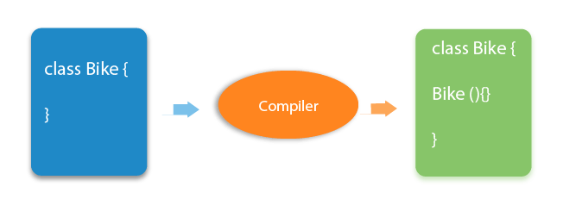

Slide 153
Example of default constructor that displays the default values
class Student3
{
int id;
String name;
void display()
{
System.out.println(id+" "+name); }
public static void main(String args[])
{
Student3 s1=new Student3();
Student3 s2=new Student3();
s1.display();
s2.display();
}
}

Slide 154
Java Parameterized Constructor
A constructor which has a specific number of parameters is called a parameterized constructor.
Why use the parameterized constructor?
The parameterized constructor is used to provide different values to distinct objects. However, you can provide the same values also.

Slide 155
Example of parameterized constructor
class Student4
{
int id;
String name;
Student4(int i,String n)
{
id = i;
name = n;
}
void display()
{
System.out.println(id+" "+name);
}
public static void main(String args[])
{
Student4 s1 = new Student4(111,"Karan");
Student4 s2 = new Student4(222,"Aryan");
s1.display();
s2.display();
}
}

Slide 156
Difference between constructor and method in Java
Java Constructor | Java Method
A constructor is used to initialize the state of an object. | A method is used to expose the behavior of an object.
A constructor must not have a return type. | A method must have a return type.
The constructor is invoked implicitly. | The method is invoked explicitly.
The Java compiler provides a default constructor if you don't have any constructor in a class. | The method is not provided by the compiler in any case.
The constructor name must be same as the class name. | The method name may or may not be same as the class name.

Slide 157
Java Copy Constructor
There is no copy constructor in Java. However, we can copy the values from one object to another like copy constructor in C++.
There are many ways to copy the values of one object into another in Java. They are:
By constructor
By assigning the values of one object into another
By clone() method of Object class
In this example, we are going to copy the values of one object into another using Java constructor.

Slide 158
class Student6
{
int id;
String name;
Student6(int i,String n){
id = i;
name = n;
}
Student6(Student6 s)
{
id = s.id;
name =s.name;
}
void display(){System.out.println(id+" "+name);}
public static void main(String args[]){
Student6 s1 = new Student6(111,"Karan");
Student6 s2 = new Student6(s1);
s1.display();
s2.display();
}
}

Slide 159
Does constructor return any value?
Yes, it is the current class instance (You cannot use return type yet it returns a value).
Can constructor perform other tasks instead of initialization?
Yes, like object creation, starting a thread, calling a method, etc. You can perform any operation in the constructor as you perform in the method.
Is there Constructor class in Java?
Yes.
What is the purpose of Constructor class?
Java provides a Constructor class which can be used to get the internal information of a constructor in the class. It is found in the java.lang.reflect package.

Slide 160
Java static keyword
The static keyword in Java is used for memory management mainly. We can apply static keyword with variables, methods, blocks and nested classes. The static keyword belongs to the class than an instance of the class.
The static can be:
Variable (also known as a class variable)
Method (also known as a class method)
Block
Nested class

Slide 161
1) Java static variable
If you declare any variable as static, it is known as a static variable.
The static variable can be used to refer to the common property of all objects (which is not unique for each object), for example, the company name of employees, college name of students, etc.
The static variable gets memory only once in the class area at the time of class loading.
Advantages of static variable
It makes your program memory efficient (i.e., it saves memory).

Slide 162
Understanding the problem without static variable
class Student{
int rollno;
String name;
String college="ITS";
}
Suppose there are 500 students in my college, now all instance data members will get memory each time when the object is created.
All students have its unique rollno and name, so instance data member is good in such case.
Here, "college" refers to the common property of all objects. If we make it static, this field will get the memory only once.

Slide 163
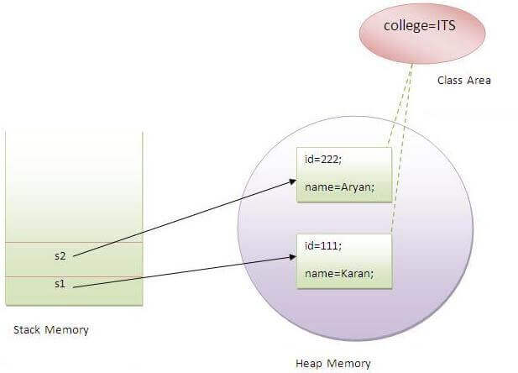

Slide 164
2) Java static method
If you apply static keyword with any method, it is known as static method.
A static method belongs to the class rather than the object of a class.
A static method can be invoked without the need for creating an instance of a class.
A static method can access static data member and can change the value of it.

Slide 165
class Student{
int rollno;
String name;
static String college = "ITS";
//static method to change the value of static variable
static void change(){
college = "BBDIT";
}
//constructor to initialize the variable
Student(int r, String n){
rollno = r;
name = n;
}
//method to display values
void display(){System.out.println(rollno+" "+name+" "+college);}
}

Slide 166
//Test class to create and display the values of object
public class TestStaticMethod{
public static void main(String args[]){
Student.change();//calling change method
//creating objects
Student s1 = new Student(111,"Karan");
Student s2 = new Student(222,"Aryan");
Student s3 = new Student(333,"Sonoo");
//calling display method
s1.display();
s2.display();
s3.display();
}
}

Slide 167
Restrictions for the static method
There are two main restrictions for the static method. They are:
The static method can not use non static data member or call non-static method directly.
this and super cannot be used in static context.
Why is the Java main method static?
Ans) It is because the object is not required to call a static method. If it were a non-static method, JVM creates an object first then call main() method that will lead the problem of extra memory allocation.

Slide 168
3) Java static block
Is used to initialize the static data member.
It is executed before the main method at the time of classloading.
Example of static block
class A2
{
static
{
System.out.println("static block is invoked");
}
public static void main(String args[])
{
System.out.println("Hello main");
}
}

Slide 169
Q) Can we execute a program without main() method?
Ans) No, one of the ways was the static block, but it was possible till JDK 1.6. Since JDK 1.7, it is not possible to execute a Java class without the main method.
class A3
{
static{
System.out.println("static block is invoked");
System.exit(0);
}
}

Slide 170
Final Keyword In Java
The final keyword in java is used to restrict the user. The java final keyword can be used in many context. Final can be:
variable
method
class
The final keyword can be applied with the variables, a final variable that have no value it is called blank final variable or uninitialized final variable. It can be initialized in the constructor only.
The blank final variable can be static also which will be initialized in the static block only.

Slide 171
1) Java final variable
If you make any variable as final, you cannot change the value of final variable(It will be constant).
Example of final variable
There is a final variable speedlimit, we are going to change the value of this variable, but It can't be changed because final variable once assigned a value can never be changed.
class Bike9
{
final int speedlimit=90;//final variable
void run()
{
speedlimit=400;
}
public static void main(String args[])
{
Bike9 obj=new Bike9();
obj.run();
}
}//end of class

Slide 172
Java final method
If you make any method as final, you cannot override it.
class Bike{
final void run(){System.out.println("running");}
}
class Honda extends Bike
{
void run(){System.out.println("running safely with 100kmph");}
public static void main(String args[]){
Honda honda= new Honda();
honda.run();
}
}

Slide 173
Java final class
If you make any class as final, you cannot extend it.
final class Bike{}
class Honda1 extends Bike{
void run(){System.out.println("running safely with 100kmph");}
public static void main(String args[]){
Honda1 honda= new Honda1();
honda.run();
}
}

Slide 174
What is blank or uninitialized final variable?
A final variable that is not initialized at the time of declaration is known as blank final variable.
If you want to create a variable that is initialized at the time of creating object and once initialized may not be changed, it is useful. For example PAN CARD number of an employee.
It can be initialized only in constructor
class Bike10{
final int speedlimit;//blank final variable
Bike10(){
speedlimit=70;
System.out.println(speedlimit);
}
public static void main(String args[]){
new Bike10();
}
}

Slide 175
static blank final variable
A static final variable that is not initialized at the time of declaration is known as static blank final variable. It can be initialized only in static block.
class A{
static final int data;//static blank final variable
static{ data=50;}
public static void main(String args[]){
System.out.println(A.data);
}
}

Slide 176
Q) Is final method inherited?
Yes, final method is inherited but you cannot override it.
Q) Can we declare a constructor final?
No, because constructor is never inherited.
Q) What is final parameter?
If you declare any parameter as final, you cannot change the value of it.

Slide 177
Access Modifiers in Java
There are two types of modifiers in Java:
access modifiers and
non-access modifiers.
The access modifiers in Java specifies the accessibility or scope of a field, method, constructor, or class. We can change the access level of fields, constructors, methods, and class by applying the access modifier on it.
There are many non-access modifiers, such as static, abstract, synchronized, native, volatile, transient, etc. Here, we are going to learn the access modifiers only.

Slide 178
There are four types of Java access modifiers:
Private: The access level of a private modifier is only within the class. It cannot be accessed from outside the class.
Default: The access level of a default modifier is only within the package. It cannot be accessed from outside the package. If you do not specify any access level, it will be the default.
Protected: The access level of a protected modifier is within the package and outside the package through child class. If you do not make the child class, it cannot be accessed from outside the package.
Public: The access level of a public modifier is everywhere. It can be accessed from within the class, outside the class, within the package and outside the package.

Slide 179
Access Modifier | within class | within package | outside package by subclass only | outside package
Private | Y | N | N | N
Default | Y | Y | N | N
Protected | Y | Y | Y | N
Public | Y | Y | Y | Y

Slide 180
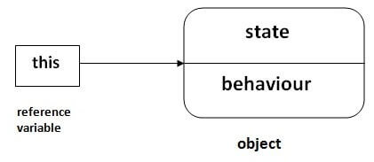
this keyword in java
There can be a lot of usage of java this keyword. In java, this is a reference variable that refers to the current object.

Slide 181
Usage of java this keyword
Here is given the 6 usage of java this keyword.
this can be used to refer current class instance variable.
this can be used to invoke current class method (implicitly)
this() can be used to invoke current class constructor.
this can be passed as an argument in the method call.
this can be passed as argument in the constructor call.
this can be used to return the current class instance from the method.

Slide 182
this: to refer current class instance variable
The this keyword can be used to refer current class instance variable. If there is ambiguity between the instance variables and parameters, this keyword resolves the problem of ambiguity.
class Student
{
int rollno;
String name;
float fee;
Student(int rollno,String name,float fee){
this.rollno=rollno;
this.name=name;
this.fee=fee;
}
void display(){System.out.println(rollno+" "+name+" "+fee);}
}

Slide 183
class TestThis2
{
public static void main(String args[])
{
Student s1=new Student(111,"ankit",5000f);
Student s2=new Student(112,"sumit",6000f);
s1.display();
s2.display();
}
}
In the above example, parameters (formal arguments) and instance variables are same. So, we are using this keyword to distinguish local variable and instance variable.

Slide 184
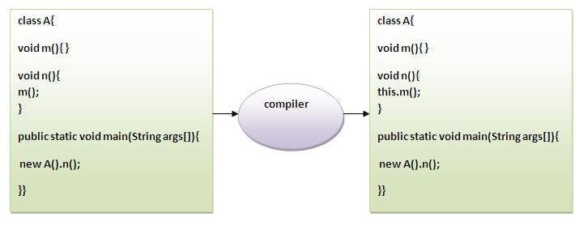
this: to invoke current class method
You may invoke the method of the current class by using the this keyword. If you don't use the this keyword, compiler automatically adds this keyword while invoking the method. Let's see the example

Slide 185
class A
{
void m(){System.out.println("hello m");}
void n(){
System.out.println("hello n");
//m();//same as this.m()
this.m();
}
}
class TestThis4
{
public static void main(String args[]){
A a=new A();
a.n();
}}

Slide 186
this() : to invoke current class constructor
The this() constructor call can be used to invoke the current class constructor. It is used to reuse the constructor. In other words, it is used for constructor chaining.
Calling default constructor from parameterized constructor:
class A{
A(){System.out.println("hello a");}
A(int x){
this();
System.out.println(x);
}
}
class TestThis5{
public static void main(String args[]){
A a=new A(10);
}}

Slide 187
Calling parameterized constructor from default constructor:
class A{
A(){
this(5);
System.out.println("hello a");
}
A(int x){
System.out.println(x);
}
}
class TestThis6{
public static void main(String args[]){
A a=new A();
}}

Slide 188
Java Garbage Collection
In java, garbage means unreferenced objects.
Garbage Collection is process of reclaiming the runtime unused memory automatically. In other words, it is a way to destroy the unused objects.
To do so, we were using free() function in C language and delete() in C++. But, in java it is performed automatically. So, java provides better memory management.
Advantage of Garbage Collection
It makes java memory efficient because garbage collector removes the unreferenced objects from heap memory.
It is automatically done by the garbage collector(a part of JVM) so we don't need to make extra efforts.

Slide 189
How can an object be unreferenced?
There are many ways:
By nulling the reference
By assigning a reference to another
1) By nulling a reference:
Employee e=new Employee();
e=null;
2) By assigning a reference to another:
Employee e1=new Employee();
Employee e2=new Employee();
e1=e2; //now the first object referred by e1 is available for garbage collection

Slide 190
finalize() method
The finalize() method is invoked each time before the object is garbage collected. This method can be used to perform cleanup processing. This method is defined in Object class as:
protected void finalize(){}
gc() method
The gc() method is used to invoke the garbage collector to perform cleanup processing. The gc() is found in System and Runtime classes.
public static void gc(){}

Slide 191
Simple Example of garbage collection in java
public class TestGarbage1
{
public void finalize(){System.out.println("object is garbage collected");}
public static void main(String args[]){
TestGarbage1 s1=new TestGarbage1();
TestGarbage1 s2=new TestGarbage1();
s1=null;
s2=null;
// requesting JVM for running Garbage Collector
System.gc();
Runtime.getRuntime().gc();
}
}

Slide 192
Nested and Inner Class
Java inner class or nested class is a class which is declared inside the class or interface.
We use inner classes to logically group classes and interfaces in one place so that it can be more readable and maintainable.
Additionally, it can access all the members of outer class including private data members and methods.
Syntax of Inner class
class Java_Outer_class{
//code
class Java_Inner_class{
//code
}
}

Slide 193
Advantage of java inner classes
There are basically three advantages of inner classes in java. They are as follows:
1) Nested classes represent a special type of relationship that is it can access all the members (data members and methods) of outer class including private.
2) Nested classes are used to develop more readable and maintainable code because it logically group classes and interfaces in one place only.
3) Code Optimization: It requires less code to write.
Difference between nested class and inner class in Java
Inner class is a part of nested class. Non-static nested classes are known as inner classes.

Slide 194
Types of Nested classes
There are two types of nested classes non-static and static nested classes. The non-static nested classes are also known as inner classes.
Non-static nested class (inner class)
Member inner class
Anonymous inner class
Local inner class
Static nested class

Slide 195
Type | Description
Member Inner Class | A class created within class and outside method.
Local Inner Class | A class created within method.
Static Nested Class | A static class created within class.
Nested Interface | An interface created within class or interface.

Slide 196
Java Member inner class example
In this example, we are creating msg() method in member inner class that is accessing the private data member of outer class.
class TestMemberOuter1{
private int data=30;
class Inner{
void msg(){System.out.println("data is "+data);}
}
public static void main(String args[]){
TestMemberOuter1 obj=new TestMemberOuter1();
TestMemberOuter1.Inner in=obj.new Inner();
in.msg();
}
}

Slide 197
Java Local inner class
A class i.e. created inside a method is called local inner class in java. If you want to invoke the methods of local inner class, you must instantiate this class inside the method.
public class localInner1{
private int data=30;//instance variable
void display(){
class Local{
void msg(){System.out.println(data);}
}
Local l=new Local();
l.msg();
}
public static void main(String args[]){
localInner1 obj=new localInner1();
obj.display();
}
}

Slide 198
Rules for Java Local Inner class
Local variable can't be private, public or protected.
Local inner class cannot be invoked from outside the method.
Local inner class cannot access non-final local variable till JDK 1.7. Since JDK 1.8, it is possible to access the non-final local variable in local inner class.

Slide 199
Java static nested class
A static class i.e. created inside a class is called static nested class in java. It cannot access non-static data members and methods. It can be accessed by outer class name.
It can access static data members of outer class including private.
Static nested class cannot access non-static (instance) data member or method.

Slide 200
Java static nested class example with instance method
class TestOuter1{
static int data=30;
static class Inner{
void msg(){System.out.println("data is "+data);}
}
public static void main(String args[]){
TestOuter1.Inner obj=new TestOuter1.Inner();
obj.msg();
}
}

Slide 201
Java Nested Interface
An interface i.e. declared within another interface or class is known as nested interface.
The nested interfaces are used to group related interfaces so that they can be easy to maintain.
The nested interface must be referred by the outer interface or class. It can't be accessed directly.
Points to remember for nested interfaces
There are given some points that should be remembered by the java programmer.
Nested interface must be public if it is declared inside the interface but it can have any access modifier if declared within the class.
Nested interfaces are declared static implicitely.

Slide 202
Syntax of nested interface which is declared within the interface
interface interface_name{
...
interface nested_interface_name{
...
}
}
Syntax of nested interface which is declared within the class
class class_name{
...
interface nested_interface_name{
...
}
}

Slide 203
String Class
In Java, string is basically an object that represents sequence of char values. An array of characters works same as Java string.
For example:
char[] ch={'j','a','v','a','t','p','o','i','n','t'};
String s=new String(ch);
is same as:
String s="javatpoint";
Java String class provides a lot of methods to perform operations on strings such as compare(), concat(), equals(), split(), length(), replace(), compareTo(), intern(), substring() etc.

Slide 204
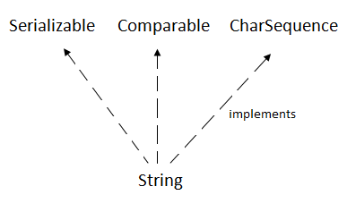
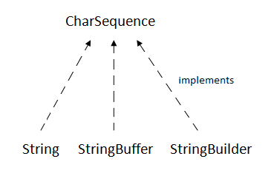
The java.lang.String class implements Serializable, Comparable and CharSequence interfaces.
CharSequence Interface
The CharSequence interface is used to represent the sequence of characters. String, StringBuffer and StringBuilder classes implement it. It means, we can create strings in java by using these three classes.

Slide 205
The Java String is immutable which means it cannot be changed. Whenever we change any string, a new instance is created. For mutable strings, you can use StringBuffer and StringBuilder classes.
What is String in java
Generally, String is a sequence of characters. But in Java, string is an object that represents a sequence of characters. The java.lang.String class is used to create a string object.
How to create a string object?
There are two ways to create String object:
By string literal
By new keyword

Slide 206
1) String Literal
Java String literal is created by using double quotes. For Example:
String s="welcome";
Each time you create a string literal, the JVM checks the "string constant pool" first. If the string already exists in the pool, a reference to the pooled instance is returned. If the string doesn't exist in the pool, a new string instance is created and placed in the pool. For example:
String s1="Welcome";
String s2="Welcome";//It doesn't create a new instance

Slide 207
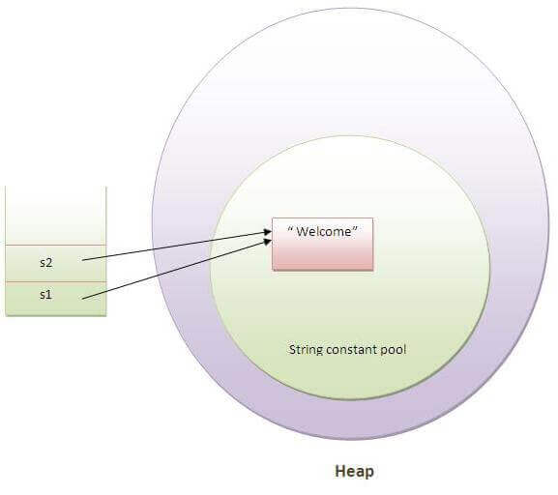

Slide 208
In the above example, only one object will be created. Firstly, JVM will not find any string object with the value "Welcome" in string constant pool, that is why it will create a new object.
After that it will find the string with the value "Welcome" in the pool, it will not create a new object but will return the reference to the same instance.
String objects are stored in a special memory area known as the "string constant pool".
Why Java uses the concept of String literal?
To make Java more memory efficient (because no new objects are created if it exists already in the string constant pool).

Slide 209
2) By new keyword
String s=new String("Welcome");//creates two objects and one reference variable
In such case, JVM will create a new string object in normal (non-pool) heap memory, and the literal "Welcome" will be placed in the string constant pool. The variable s will refer to the object in a heap (non-pool).
public class StringExample{
public static void main(String args[]){
String s1="java";//creating string by java string literal
char ch[]={'s','t','r','i','n','g','s'};
String s2=new String(ch);//converting char array to string
String s3=new String("example");//creating java string by new keyword
System.out.println(s1);
System.out.println(s2);
System.out.println(s3);
}}

Slide 210
Java String class methods
The java.lang.String class provides many useful methods to perform operations on sequence of char values.
No. | Method | Description
1 | char charAt(int index) | returns char value for the particular index
2 | int length() | returns string length
3 | static String format(String format, Object... args) | returns a formatted string.
4 | static String format(Locale l, String format, Object... args) | returns formatted string with given locale.
5 | String substring(int beginIndex) | returns substring for given begin index.
6 | String substring(int beginIndex, int endIndex) | returns substring for given begin index and end index.
7 | boolean contains(CharSequence s) | returns true or false after matching the sequence of char value.

Slide 211
8 | static String join(CharSequence delimiter, CharSequence... elements) | returns a joined string.
9 | static String join(CharSequence delimiter, Iterable<? extends CharSequence> elements) | returns a joined string.
10 | boolean equals(Object another) | checks the equality of string with the given object.
11 | boolean isEmpty() | checks if string is empty.
12 | String concat(String str) | concatenates the specified string.
13 | String replace(char old, char new) | replaces all occurrences of the specified char value.

Slide 212
14 | String replace(CharSequence old, CharSequence new) | replaces all occurrences of the specified CharSequence.
15 | static String equalsIgnoreCase(String another) | compares another string. It doesn't check case.
16 | String[] split(String regex) | returns a split string matching regex.
17 | String[] split(String regex, int limit) | returns a split string matching regex and limit.
18 | String intern() | returns an interned string.

Slide 213
19 | int indexOf(int ch) | returns the specified char value index.
20 | int indexOf(int ch, int fromIndex) | returns the specified char value index starting with given index.
21 | int indexOf(String substring) | returns the specified substring index.
22 | int indexOf(String substring, int fromIndex) | returns the specified substring index starting with given index.
23 | String toLowerCase() | returns a string in lowercase.

Slide 214
24 | String toLowerCase(Locale l) | returns a string in lowercase using specified locale.
25 | String toUpperCase() | returns a string in uppercase.
26 | String toUpperCase(Locale l) | returns a string in uppercase using specified locale.
27 | String trim() | removes beginning and ending spaces of this string.
28 | static String valueOf(int value) | converts given type into string. It is an overloaded method.

Slide 215
Java StringBuffer class
No. | String | StringBuffer
1) | String class is immutable. | StringBuffer class is mutable.
2) | String is slow and consumes more memory when you concat too many strings because every time it creates new instance. | StringBuffer is fast and consumes less memory when you cancat strings.
3) | String class overrides the equals() method of Object class. So you can compare the contents of two strings by equals() method. | StringBuffer class doesn't override the equals() method of Object class.

Slide 216
Difference between StringBuffer and StringBuilder
No. | StringBuffer | StringBuilder
1) | StringBuffer is synchronized i.e. thread safe. It means two threads can't call the methods of StringBuffer simultaneously. | StringBuilder is non-synchronized i.e. not thread safe. It means two threads can call the methods of StringBuilder simultaneously.
2) | StringBuffer is less efficient than StringBuilder. | StringBuilder is more efficient than StringBuffer.

Slide 217
Example
// Java program to demonstrate difference
// between String, StringBuilder and StringBuffer
class Geeksforgeeks {
// Concatenates to String
public static void concat1(String s1)
{
s1 = s1 + "forgeeks";
}
// Concatenates to StringBuilder
public static void concat2(StringBuilder s2)
{
s2.append("forgeeks");
}
// Concatenates to StringBuffer
public static void concat3(StringBuffer s3)
{
s3.append("forgeeks");
}

Slide 218
public static void main(String[] args)
{
String s1 = "Geeks";
// s1 is not changed
concat1(s1);
System.out.println("String: " + s1);
StringBuilder s2 = new StringBuilder("Geeks");
// s2 is changed
concat2(s2);
System.out.println("StringBuilder: " + s2);
StringBuffer s3 = new StringBuffer("Geeks");
// s3 is changed
concat3(s3);
System.out.println("StringBuffer: " + s3);
}
}
OUTPUT:
String: Geeks
StringBuilder: Geeksforgeeks
StringBuffer: Geeksforgeeks

Slide 219
End of I Unit

